Slide 1

HDMapping v0.95
MapsHD/HDMapping
januszbedkowski@gmail.com

Slide 2
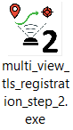
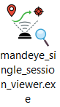
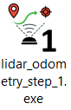
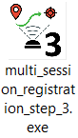
Workflow diagram
Ground truth session
QC 1
Data collection
mandeye_raw_data_viewer
QC 2
Data publication (LAZ)

Slide 3
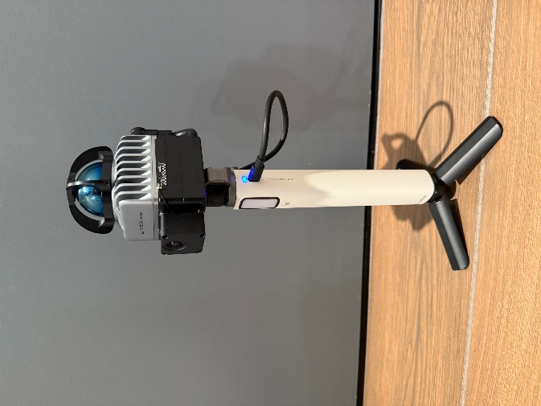
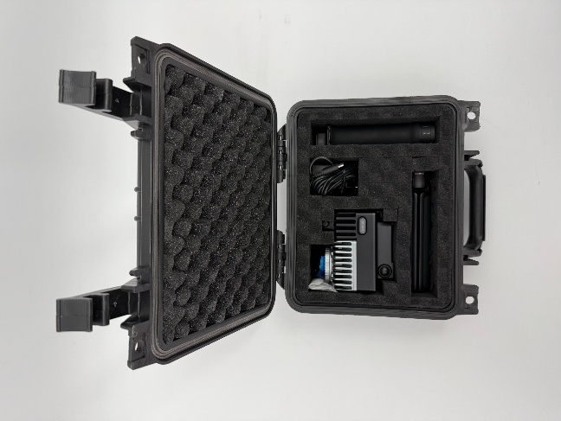
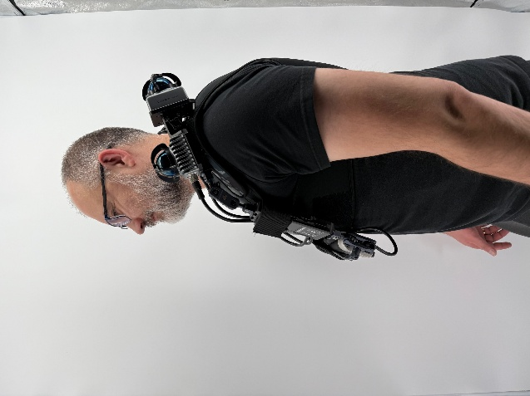
Data collection with MANDEYEs
Data collection

Slide 4
Data collection with MANDEYE-D
Data collection
Just plug wire to white handle, wait 1 minute and go.

Slide 5
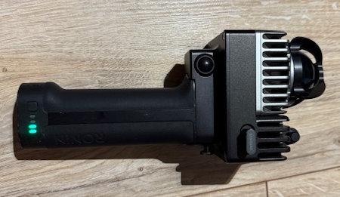
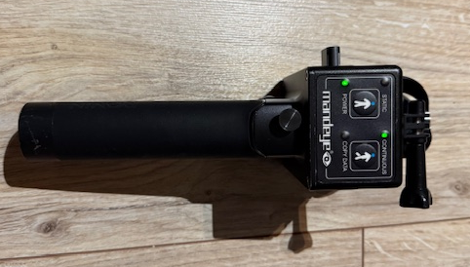
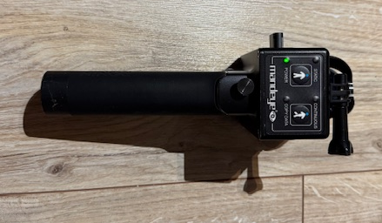
Data collection with MANDEYE-PRO
Data collection
Continuous scan,
Press once to start,
Press once to stop.
Power buttons
Warming up led
Single scan

Slide 6
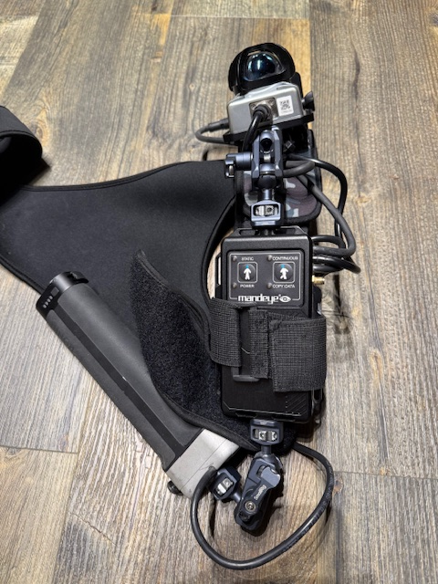
Data collection with MANDEYE-MR
Data collection
Continuous scan,
Press once to start,
Press fast triple times to stop.
Single scan
Power buttons

Slide 7
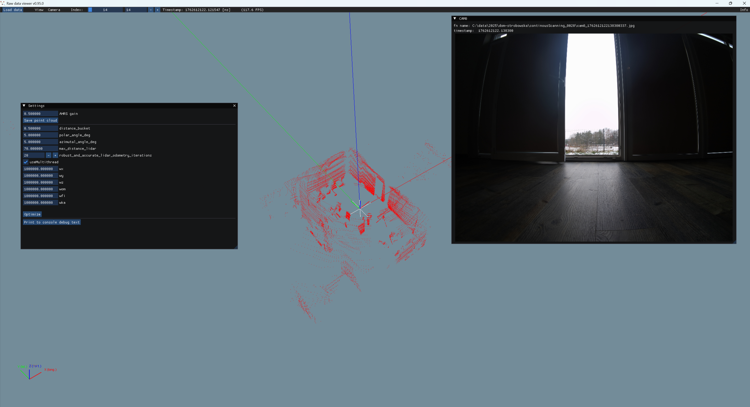
MANDEYE raw data viewer
mandeye_raw_data_viewer
This software helps in MANDEYE raw data inspection.

Slide 8
MANDEYE raw data viewer
mandeye_raw_data_viewer
This software helps in MANDEYE raw data inspection.

Slide 9
MANDEYE raw data QC 1 (Quality Control 1)
QC 1
We check raw data and if everything is ok we can proceed to lidar odometry step 1,
if not please consider collecting data again.

Slide 10
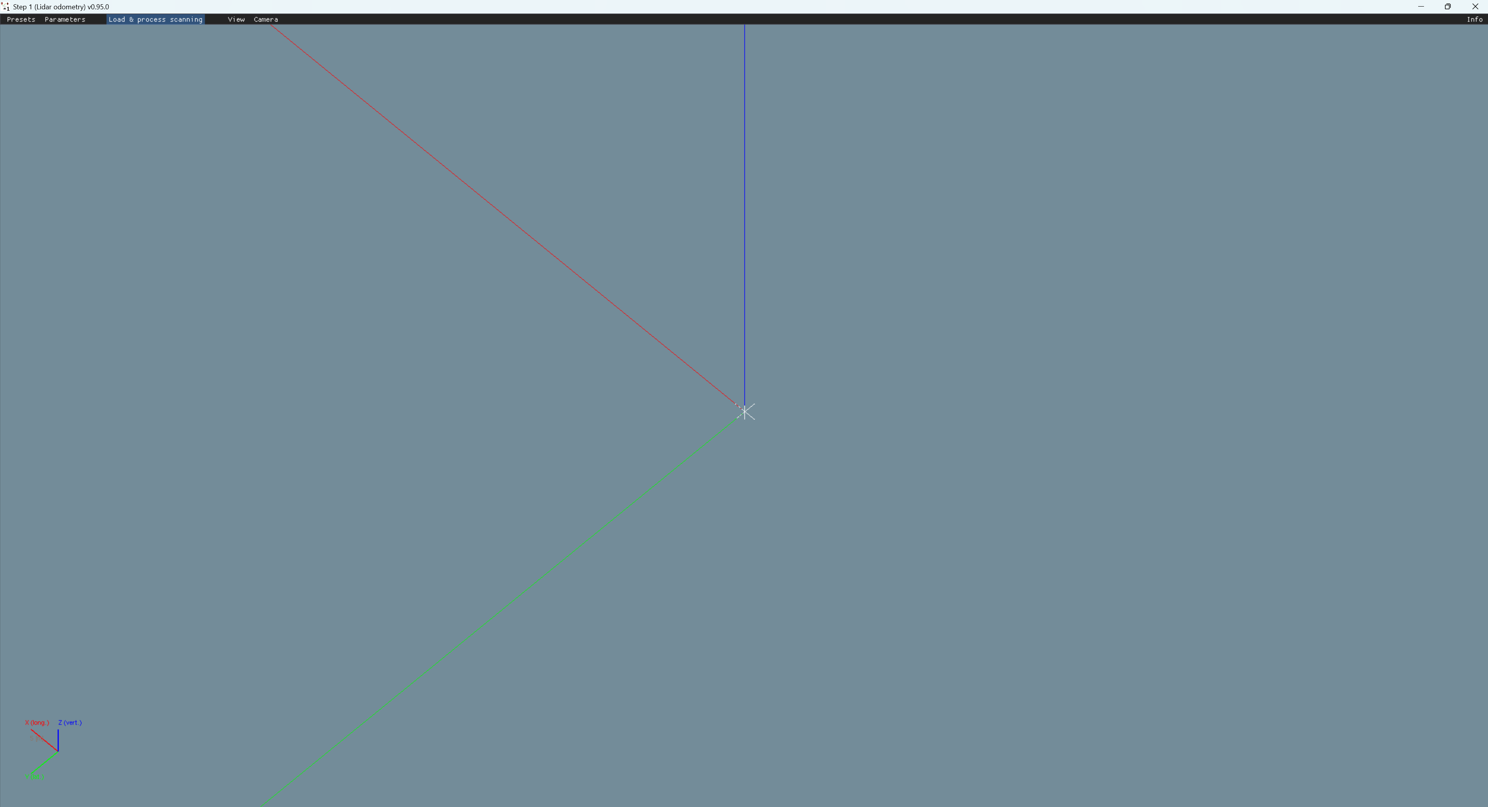
LiDAR odometry step 1
Load data from folder and process.

Slide 11
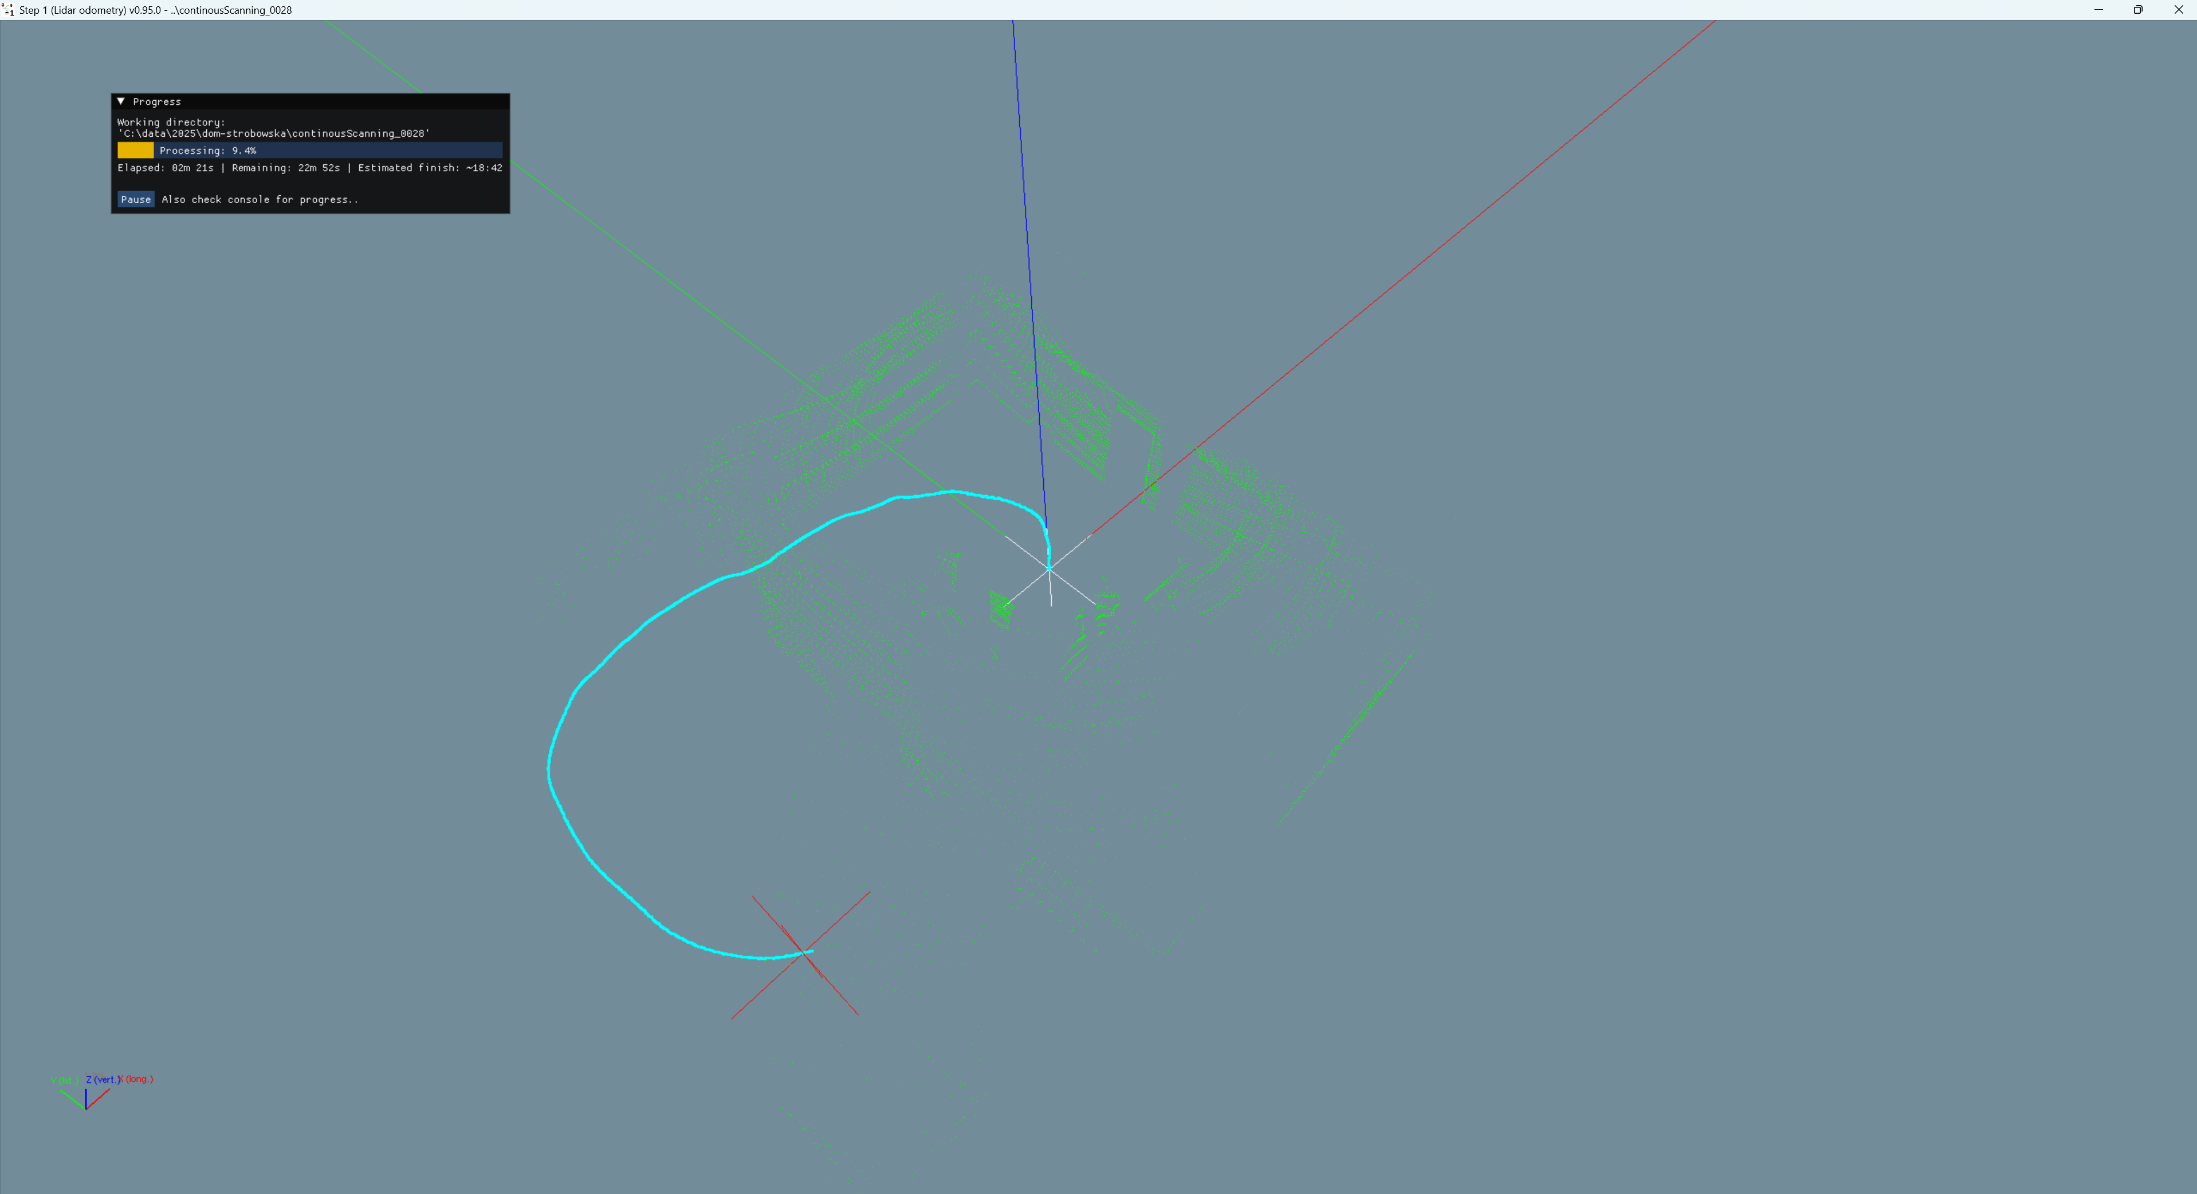
LiDAR odometry step 1
progress
trajectory

Slide 12
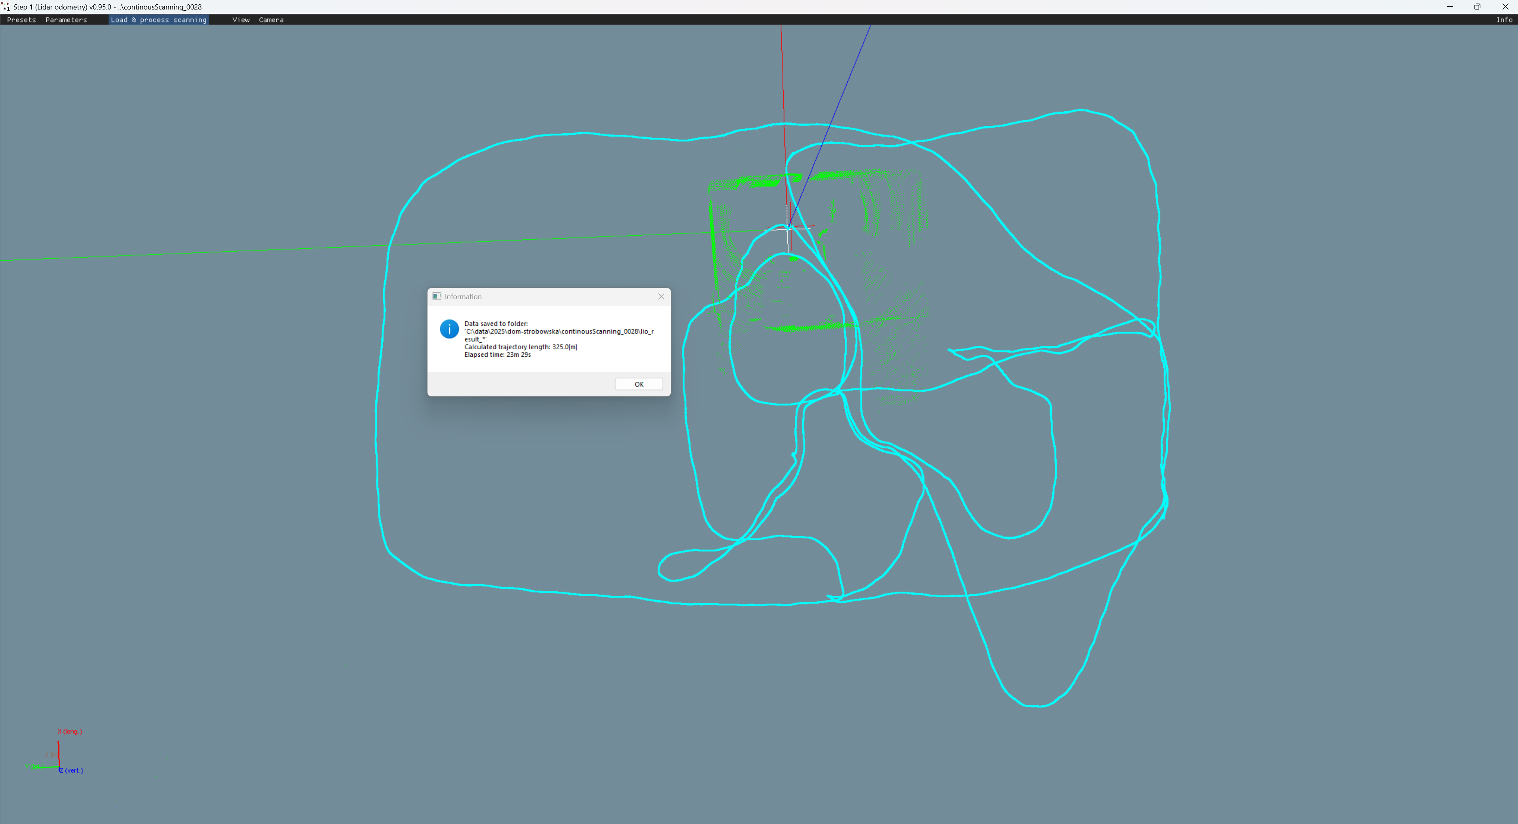
LiDAR odometry step 1
Info:
data folder with
saved data for step 2,
trajectory length,
time of calculations.

Slide 13
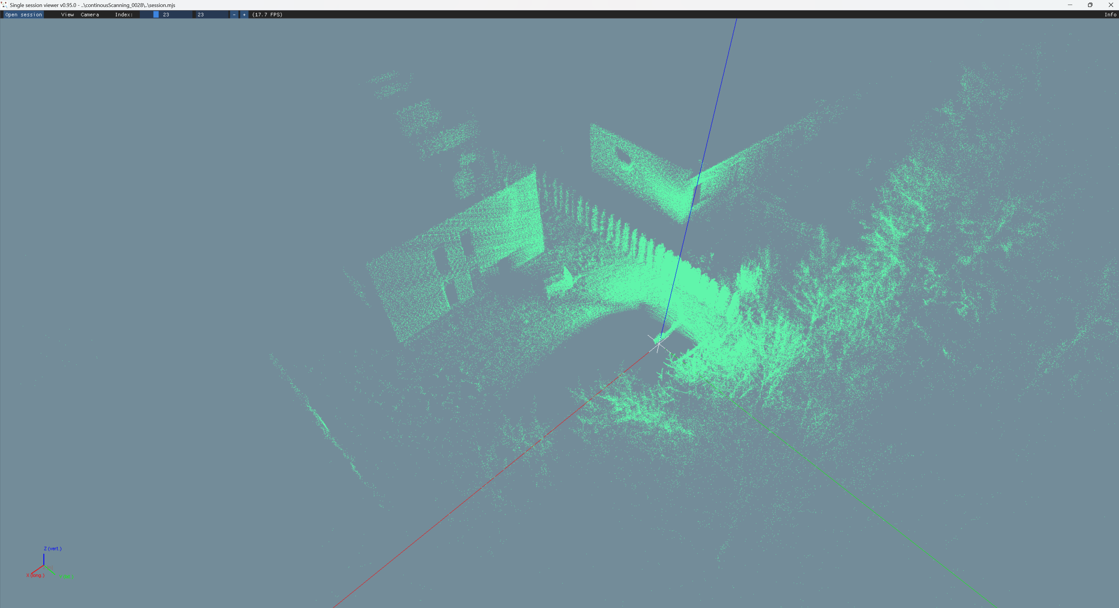
MANDEYE single session viewer

Slide 14
MANDEYE single session QC 2 (Quality control 2)
QC 2
We check session data and if everything is ok, we can proceed to multi view tls registration step 2,
if not please consider split session into half by removing corrupted interval.

Slide 15
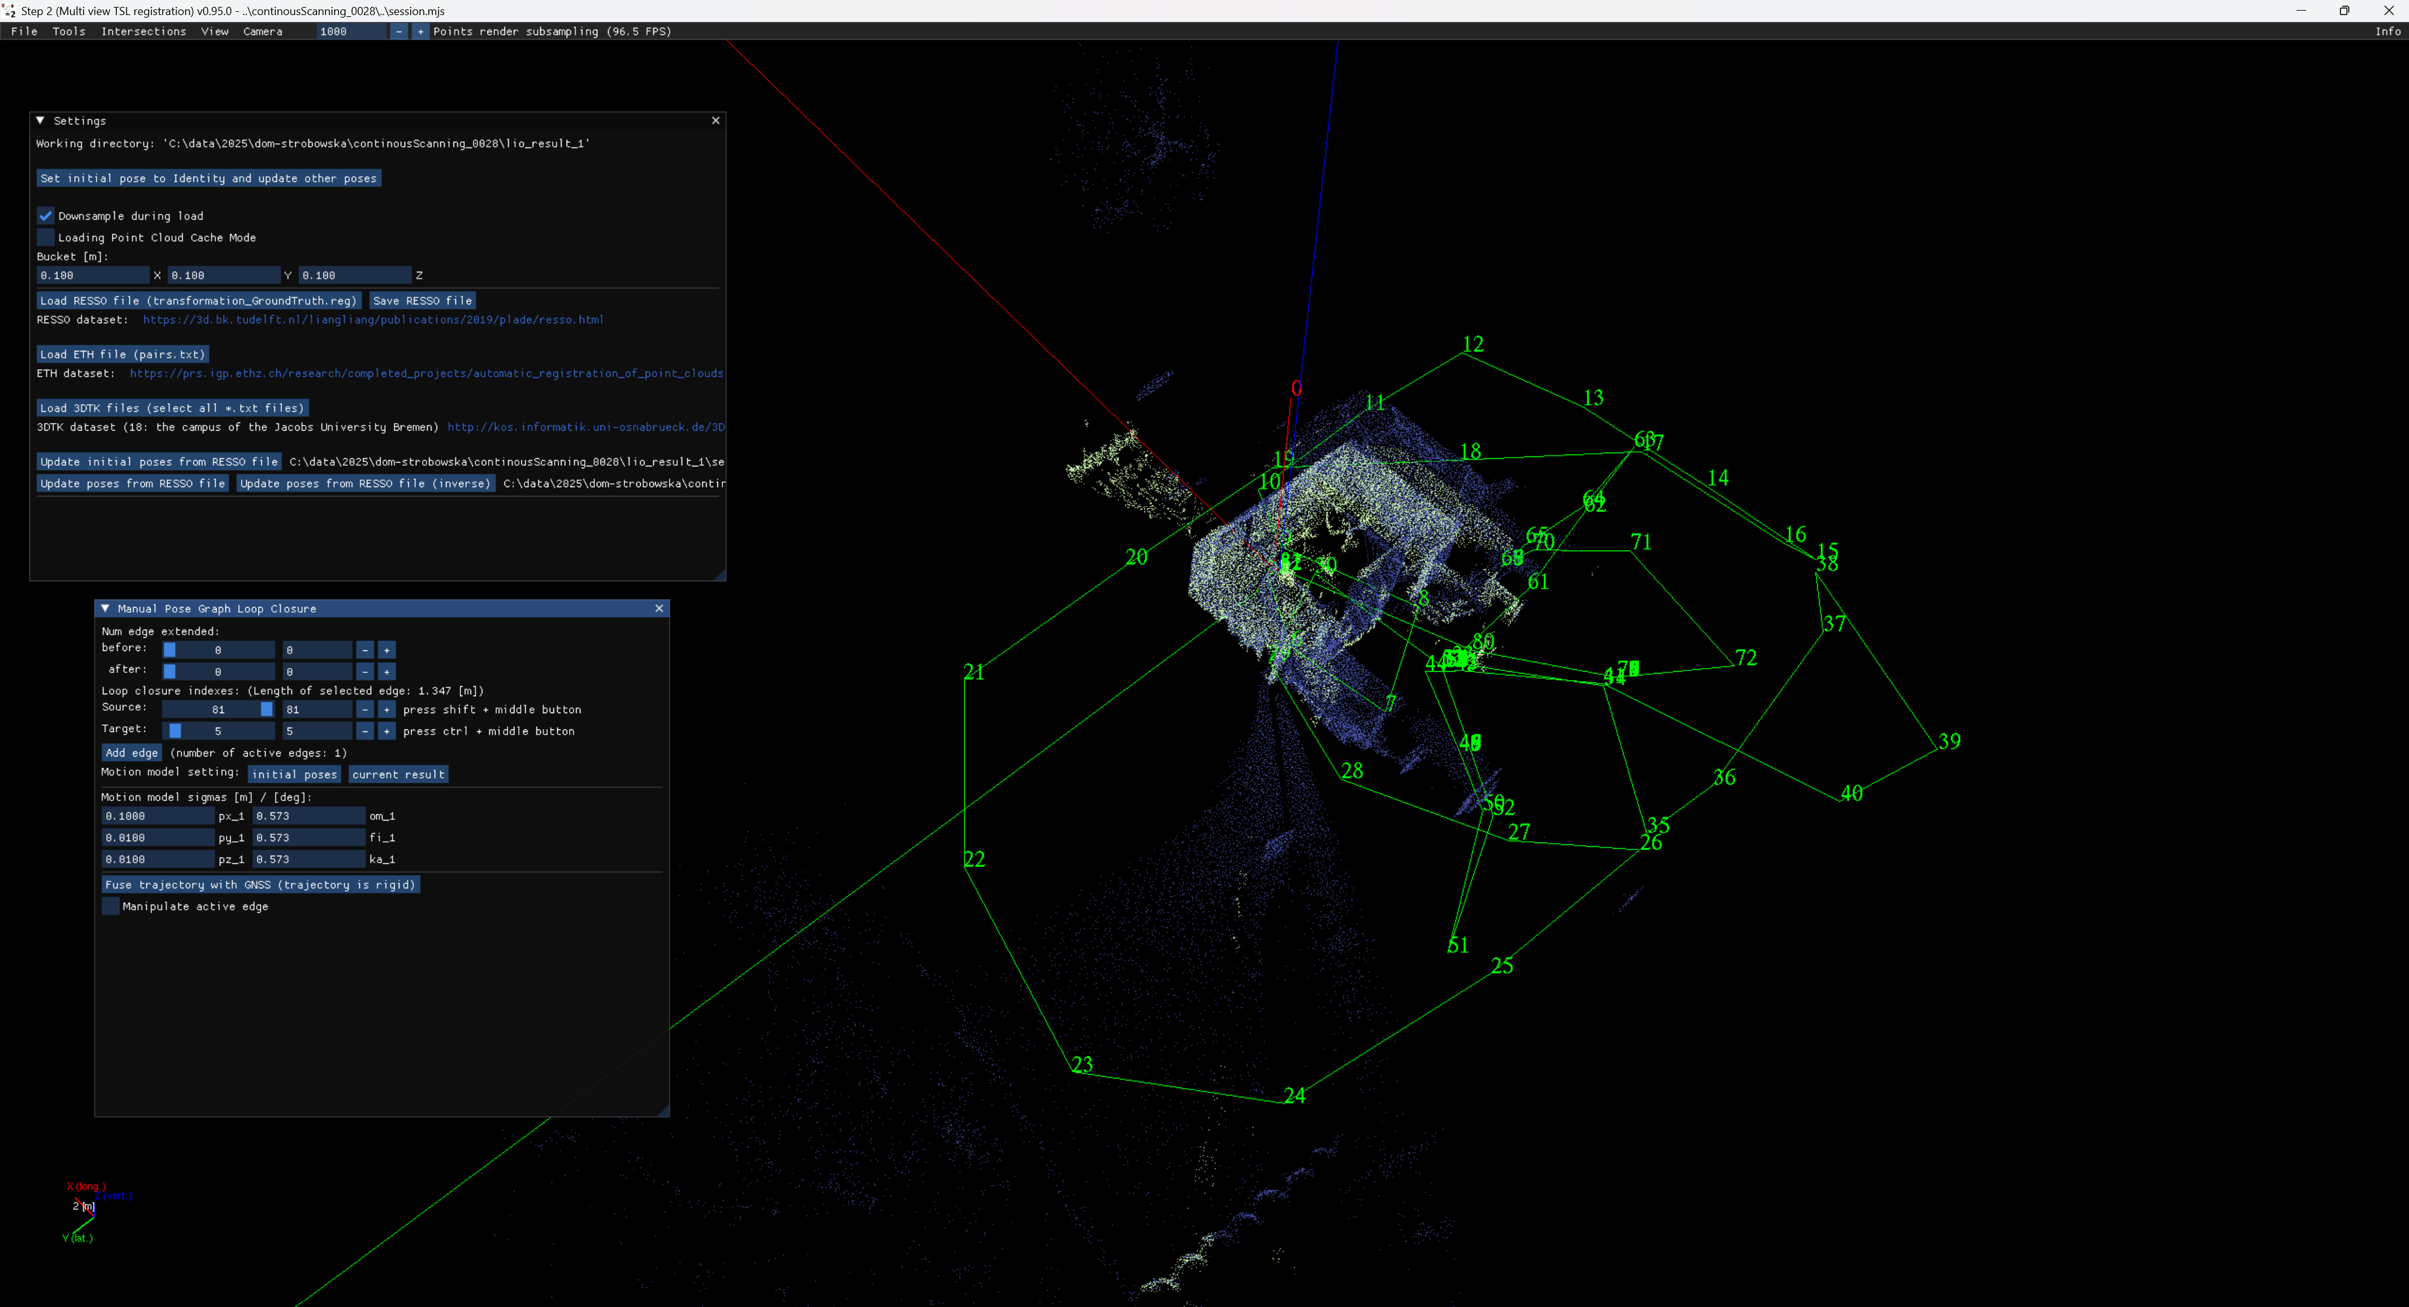
Multi view tls registration step 2

Slide 16
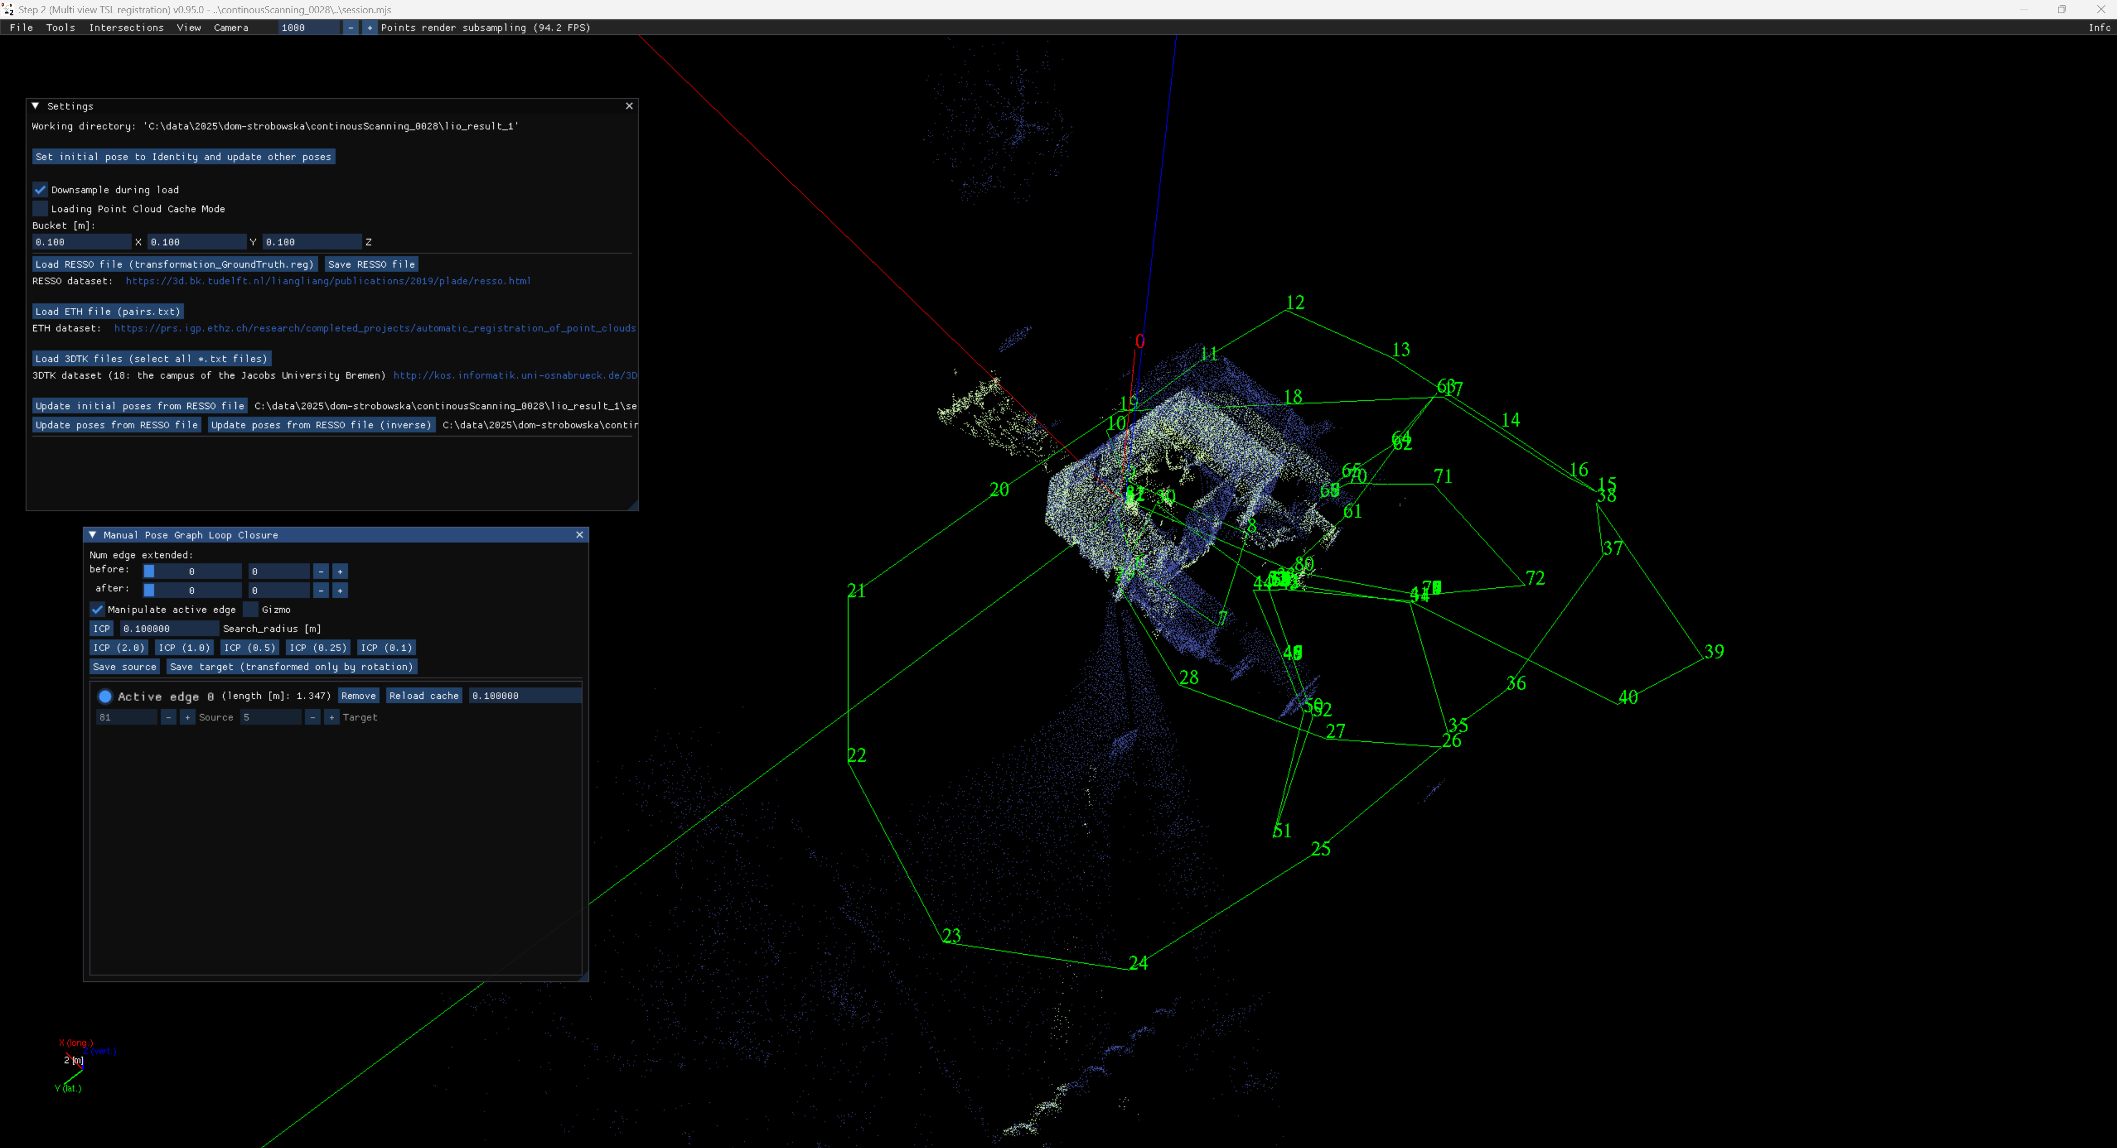
Multi view tls registration step 2

Slide 17

Multi view tls registration step 2

Slide 18
For the help with more sophisticated options please send email januszbedkowski@gmail.com please remember that this software can do a lot, unfortunately it is still under a development. This documentation is limited, we encourage to contact via email or by writing issue GitHub · Where software is built.

Slide 19
Assumptions:
1. Project is composed of multiple sessions
2. Only one session in the project can be „ground truth”
3. multi_session_registration_step_3.exe performs pose graph slam
4. It is possible to add Edge for single session (similar to multi_view_tls_registration_step_2.exe)
5. It is possible to add Edge for two different sessions
6. „Ground truth” can not be changed (gizmo is disabled), only multi_view_tls_registration_step_2.exe can change „Ground truth” flag

Slide 20
Inspect data with
mandeye_raw_data_viewer
QC 1

Slide 21
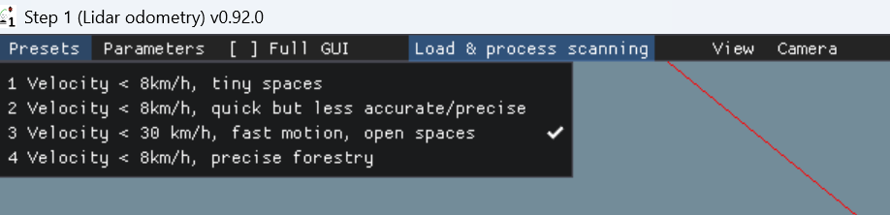
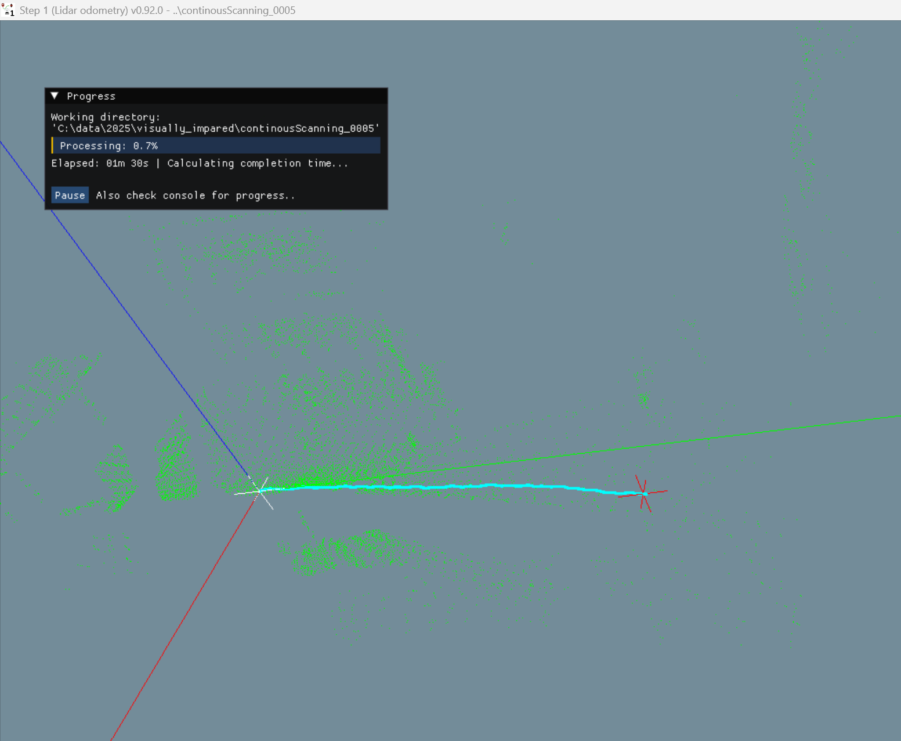
LiDAR inertial odometry
Software: lidar_odometry_step_1.exe
Choose one of Presets
- Velocity < 8km/h is dedicated for caves, tiny spaces, inside tiny rooms
- Velocity < 8km/h, quick but less accurate/precise is using less iterations in optimization
- Velocity < 30km/h, fast motion, open spaces removes points in 3m radious so it can not be used in tiny spaces
- Velocity < 8km/h, precise forestry is for making map in the forest
2. Load & proces scanning
- seclect folder containing MANDEYE data
- observe trajectory

Slide 22
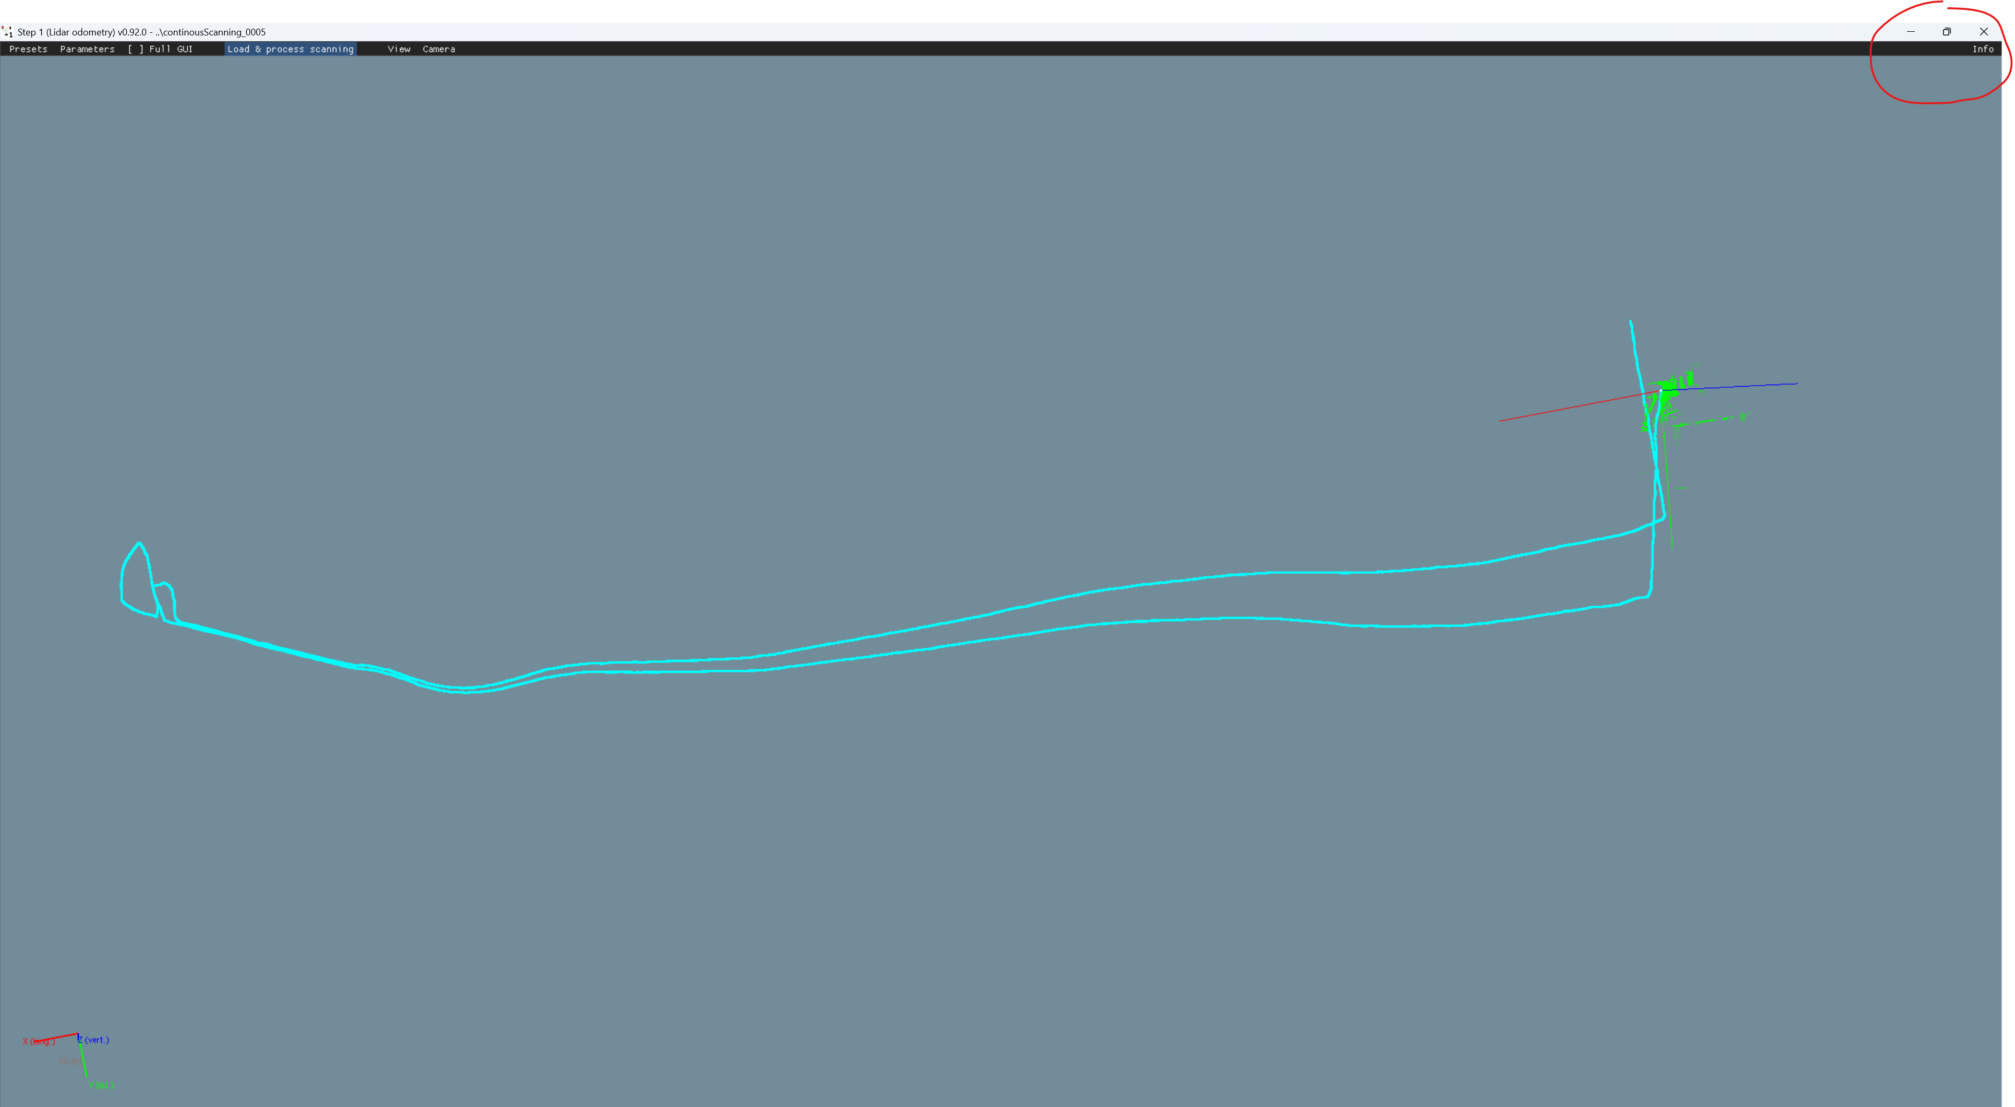
LiDAR inertial odometry
Software: lidar_odometry_step_1.exe
Finally, program will inform where data is saved.

Slide 23
Inspect data with
QC 2

Slide 24
IMU versus LiDAR inertial odometry error quality check

Slide 25
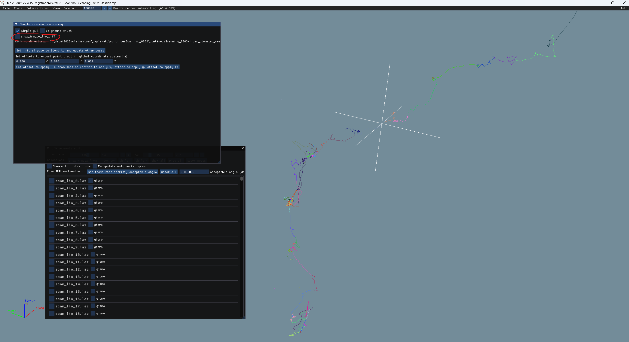
After session load in step2, use show_imu_to_lio_diff to check for large differences between LiDAR and IMU estimations

Slide 26


Slide 27
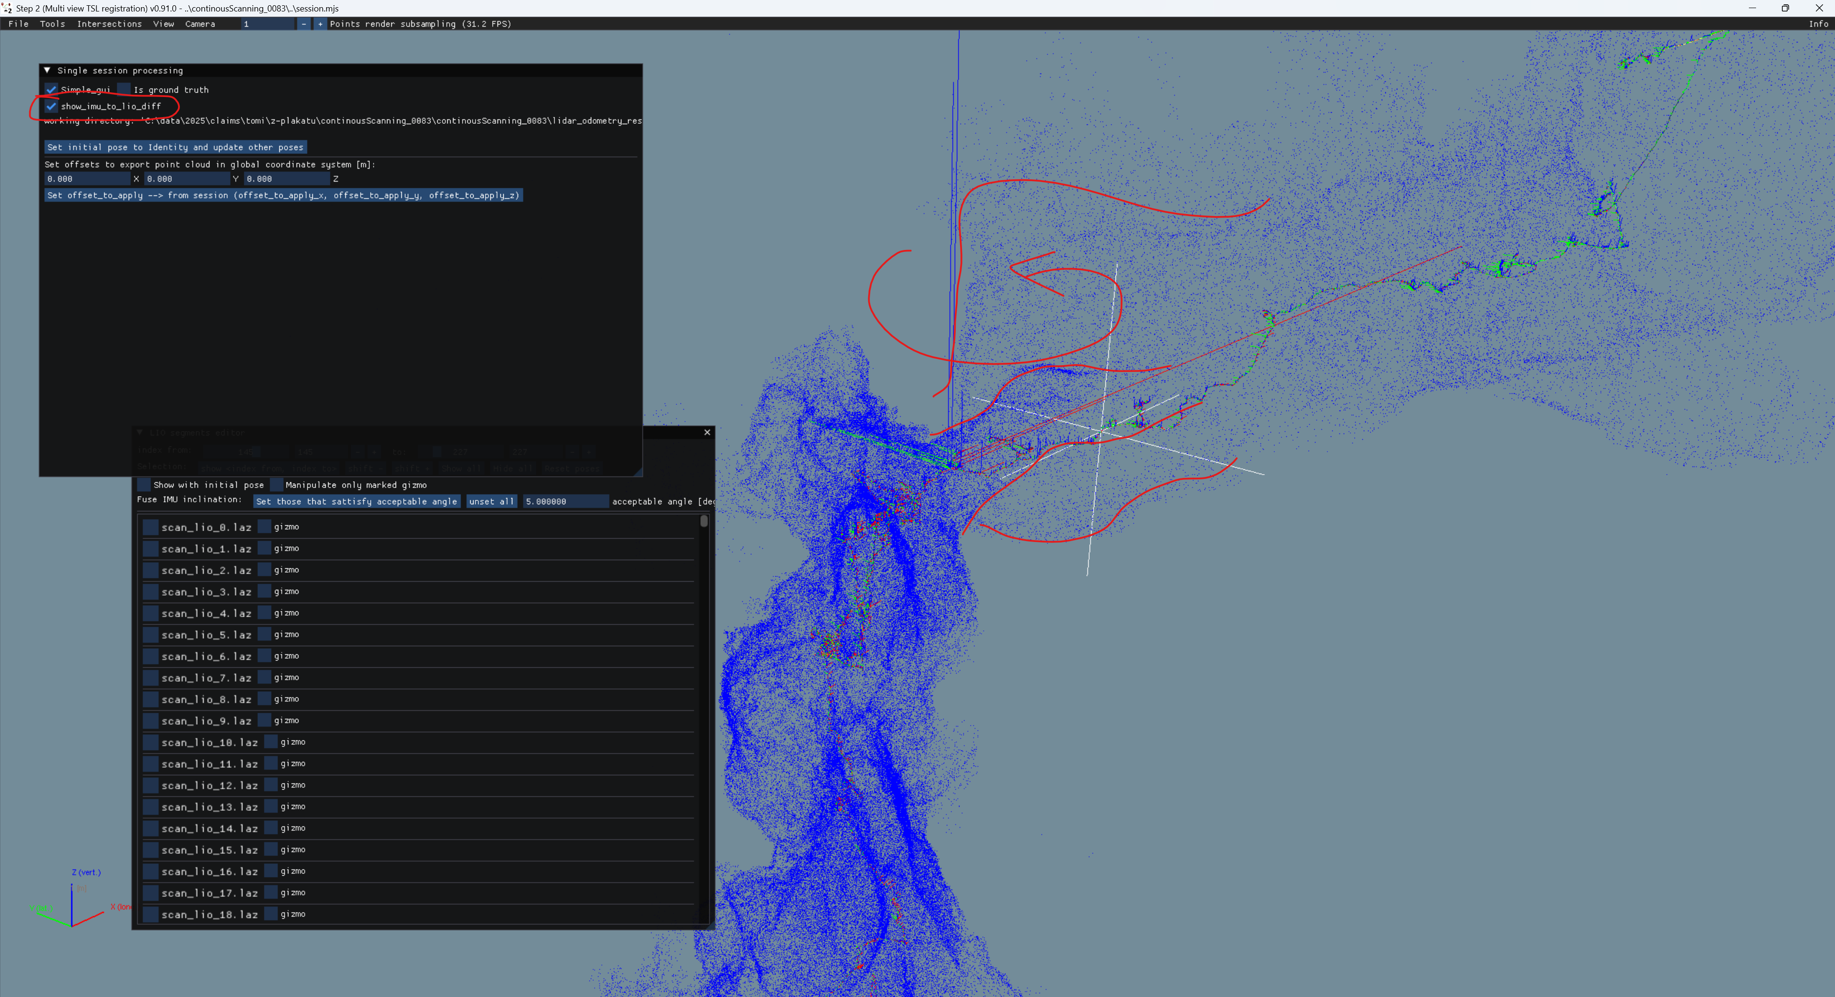
WHAT IS SHOWN HERE???

Slide 28
Split session ToDo
Once the error in session is identified it is advised to split session with omitting corrupted data

Slide 29
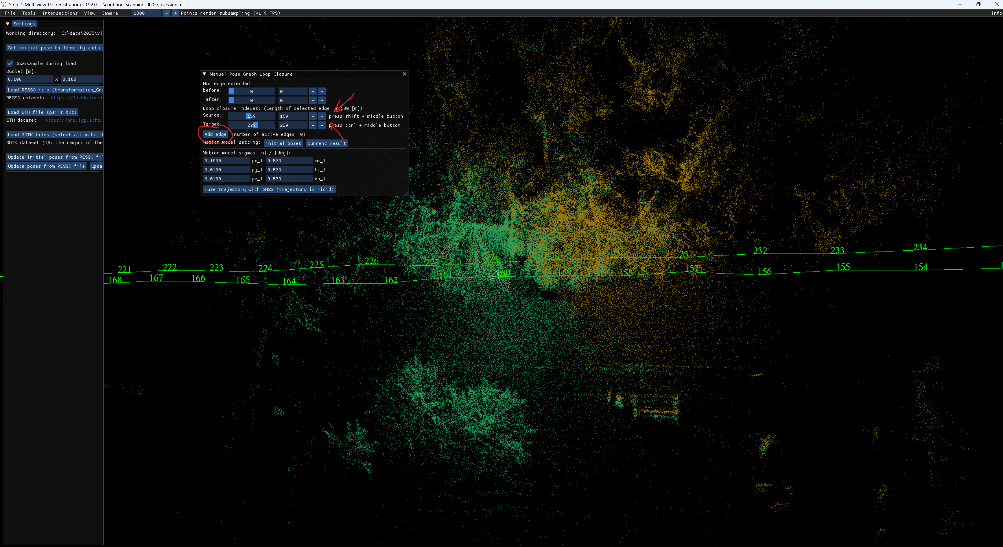

Slide 30
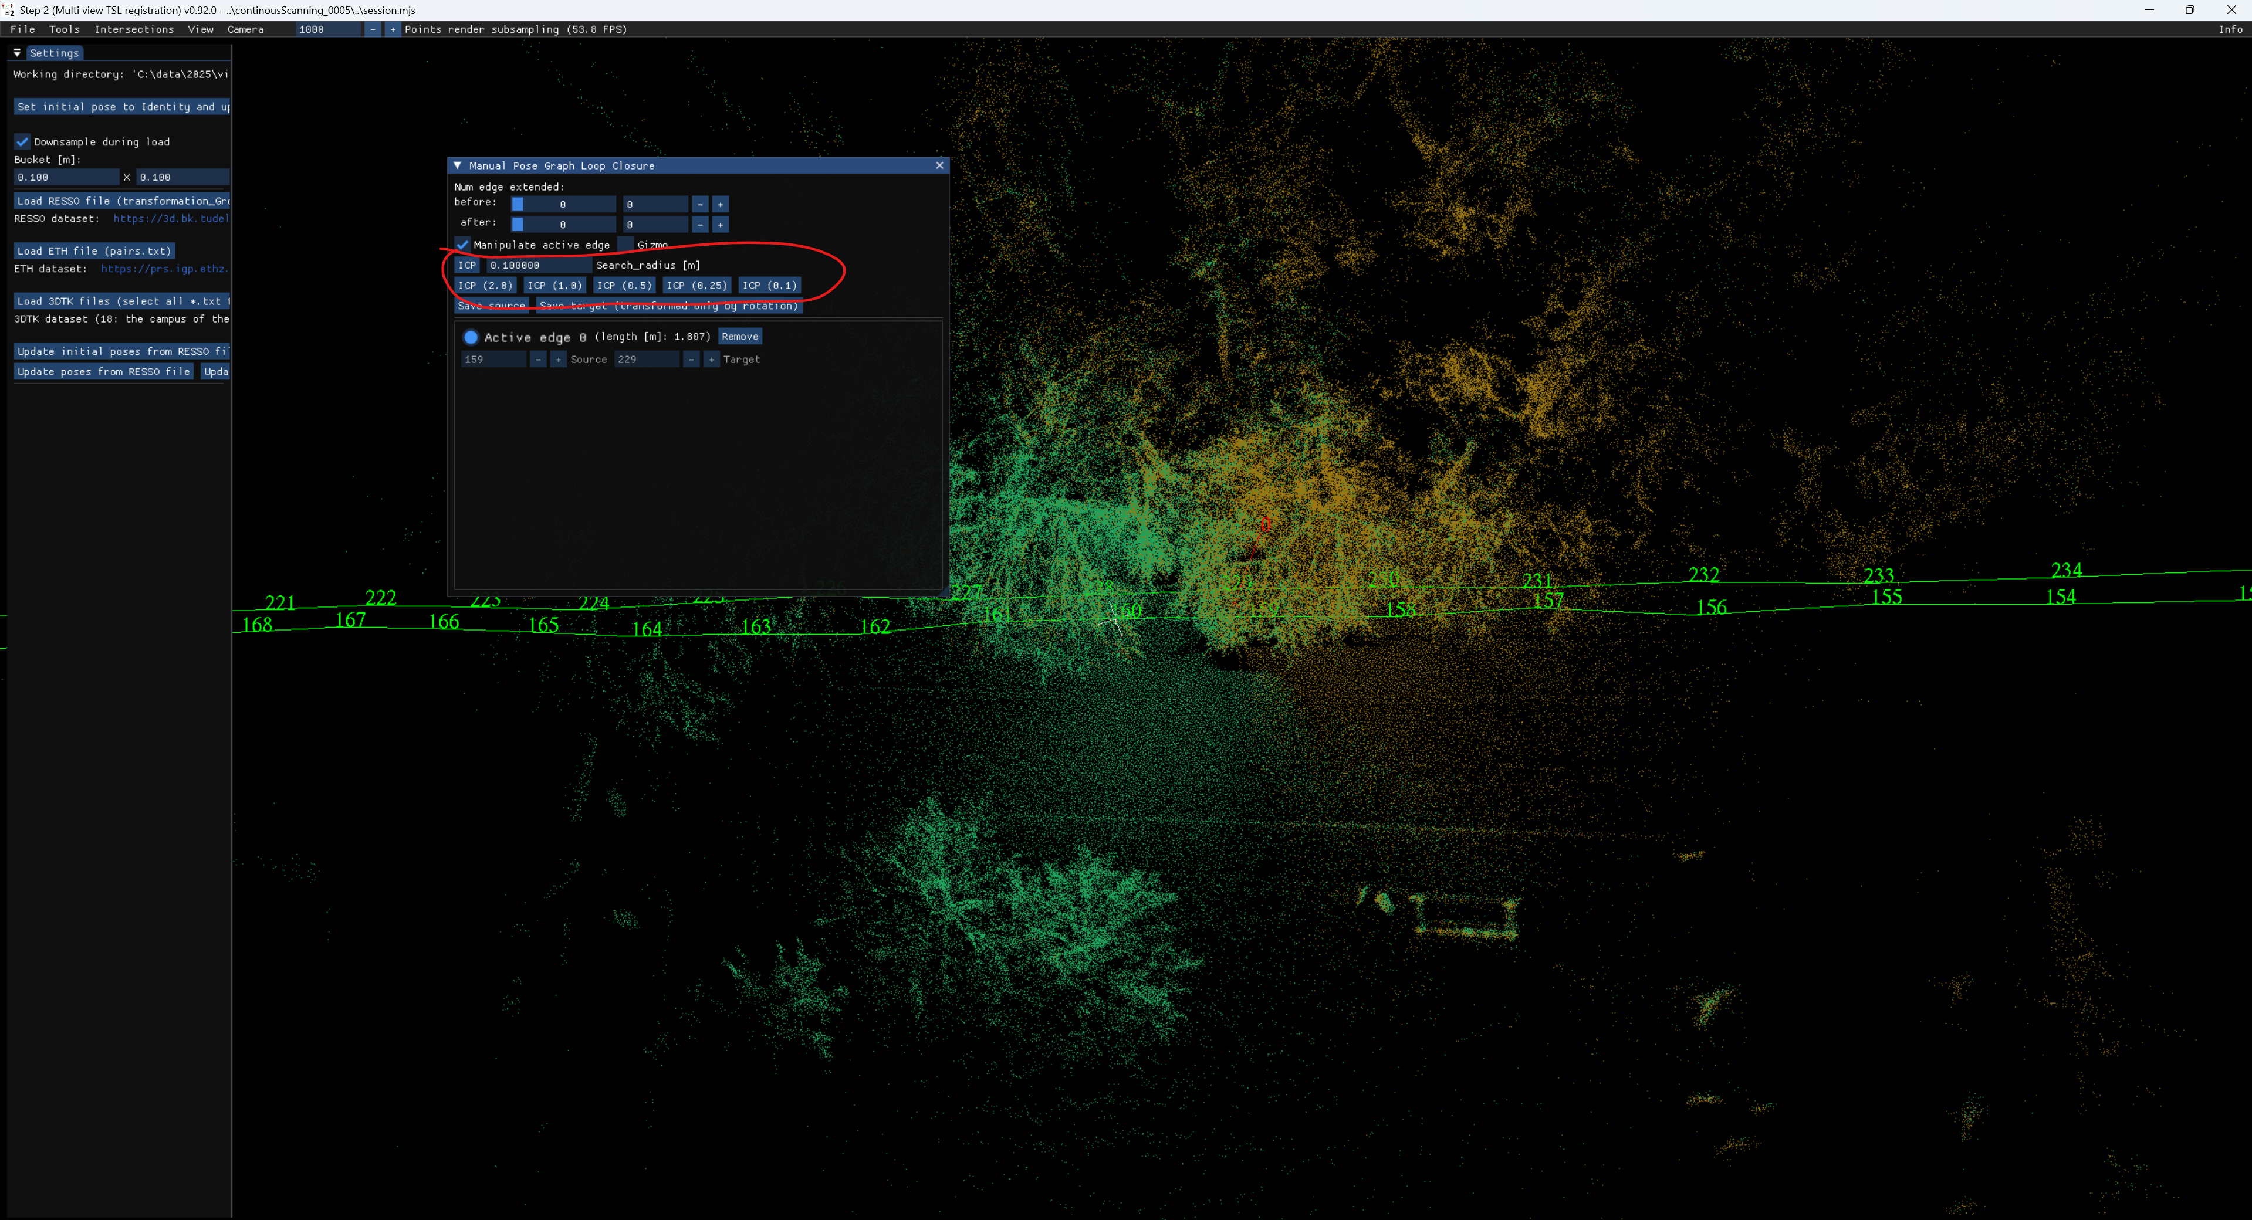

Slide 31
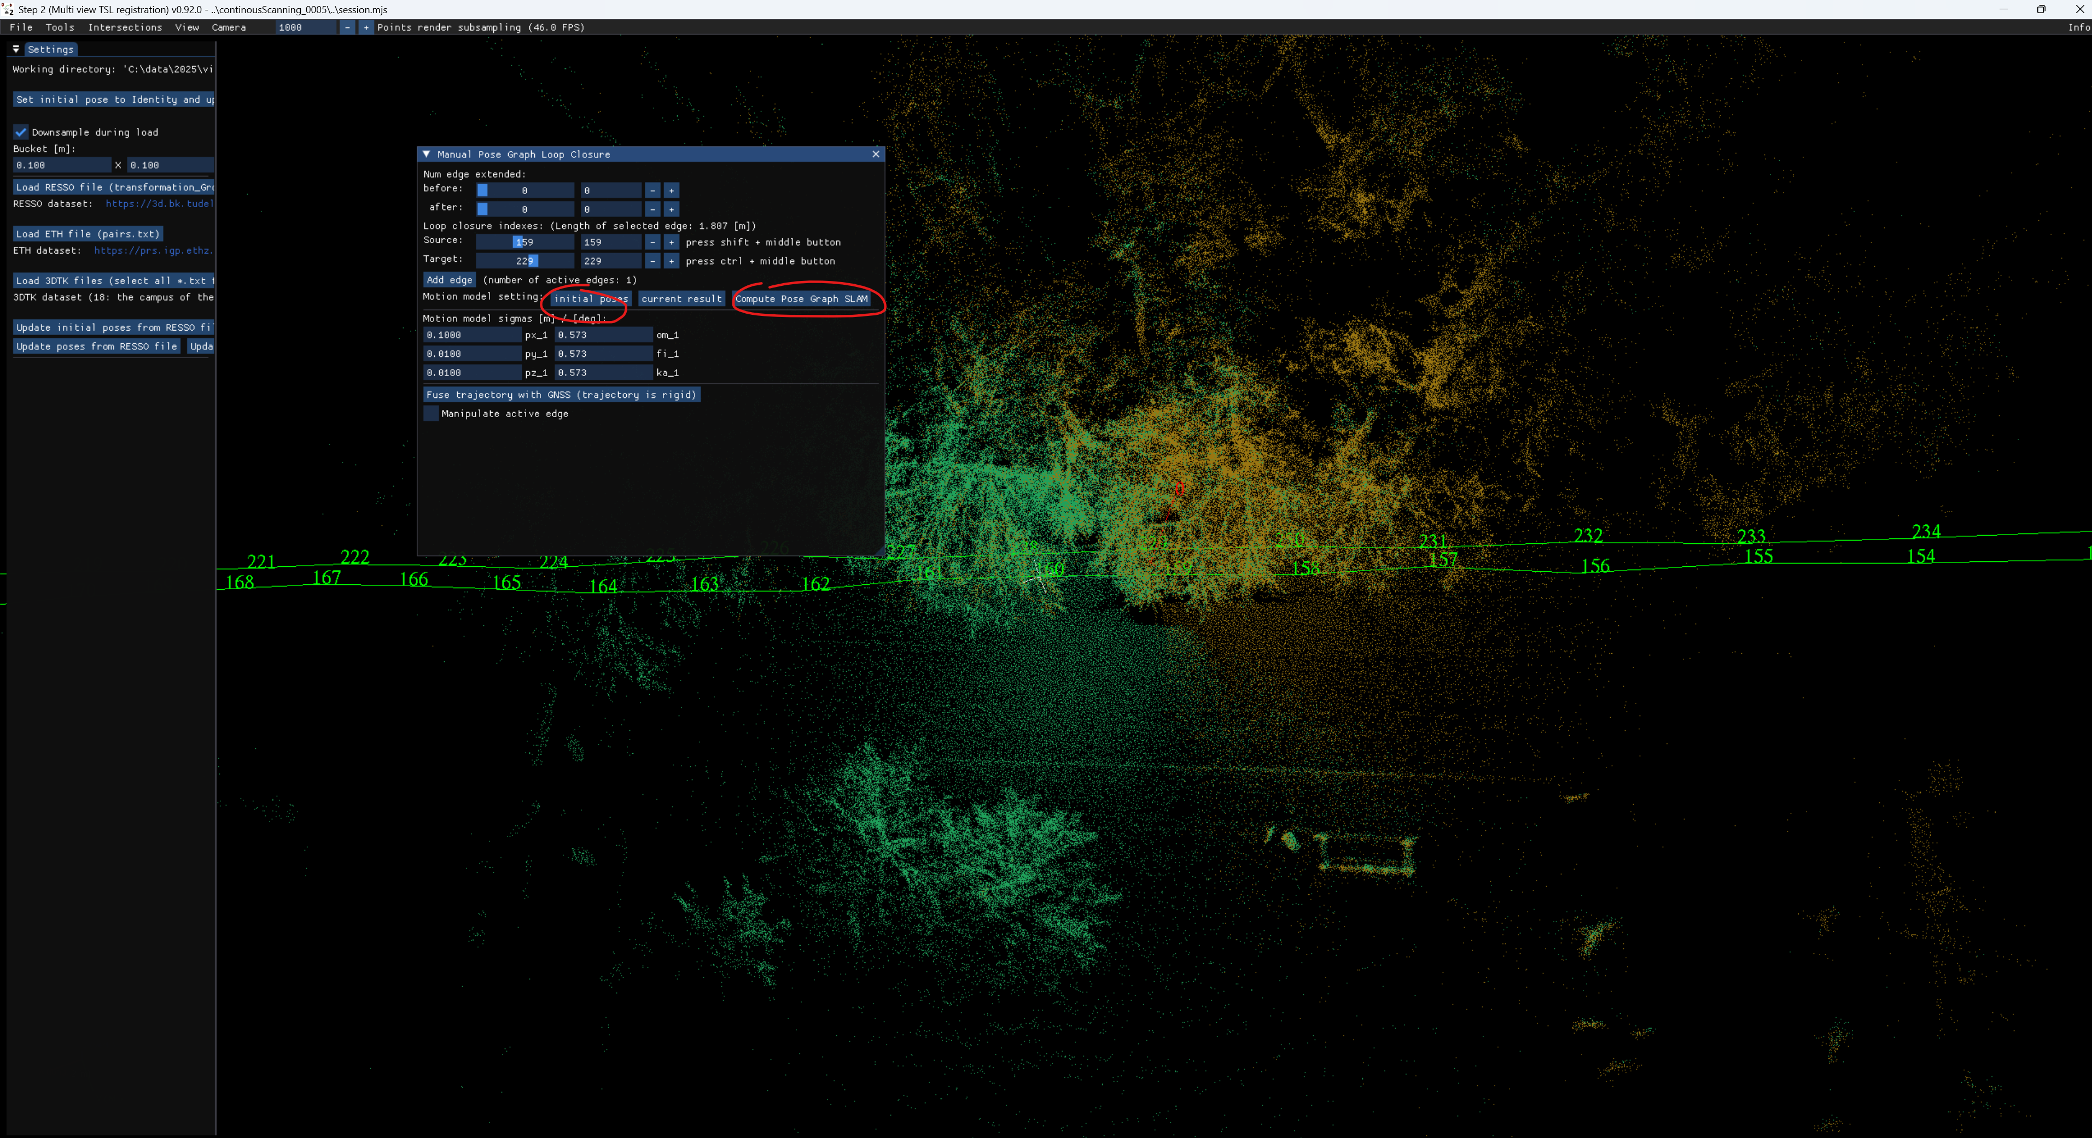

Slide 32
Georeferencing to ground truth point cloud

Slide 33
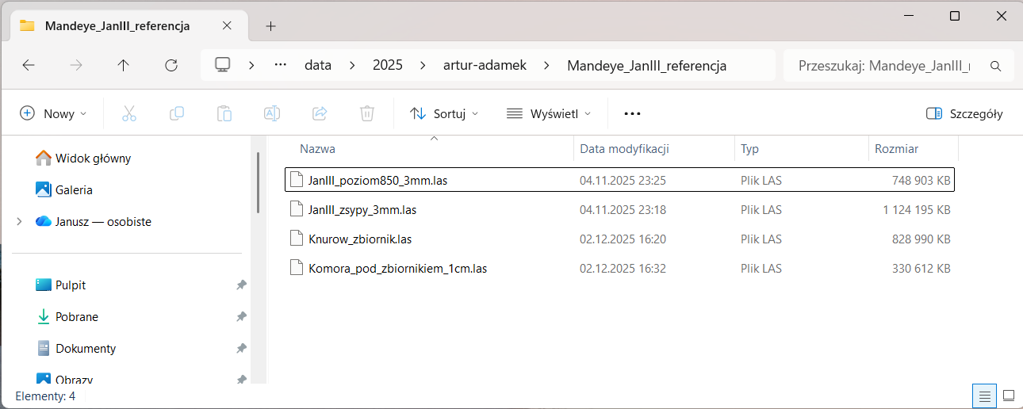
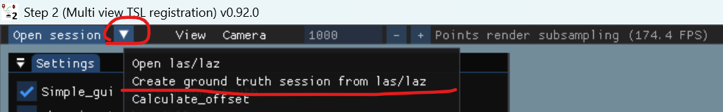
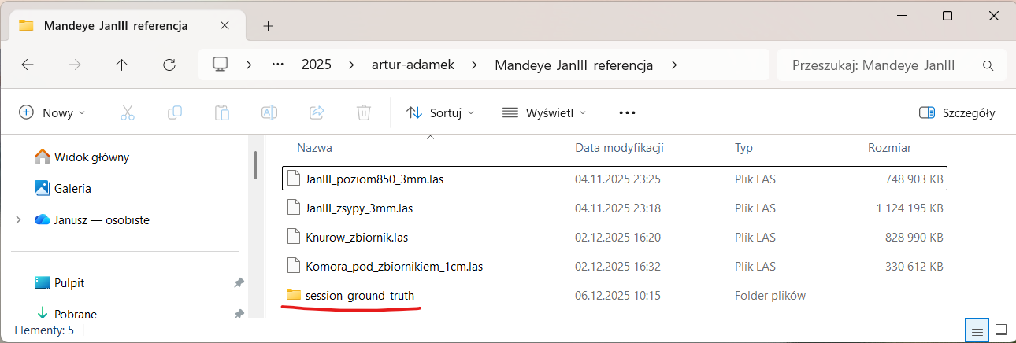
Creating ground truth session from point clouds
1. Using multi_view_tls_registration_step_2.exe
collect ground truth point clouds (laz/las) in one folder
2. Click in menu Create ground truth session from las/laz
3. New session_ground_truth will appear -> use it in step3

Slide 34
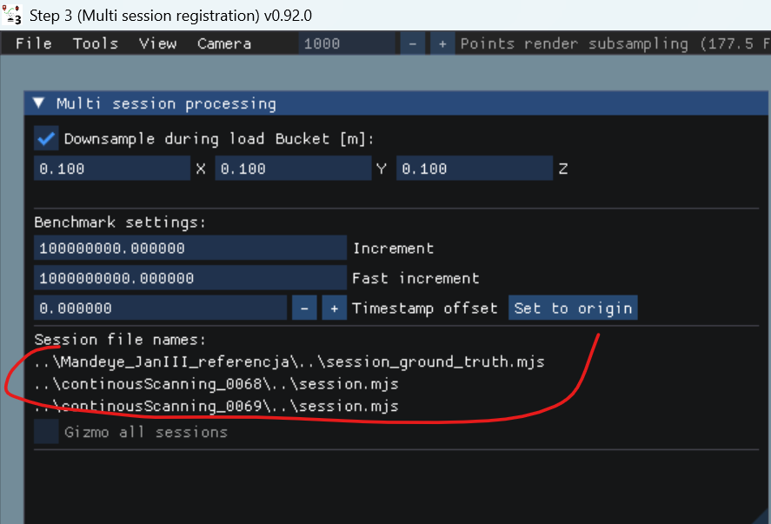
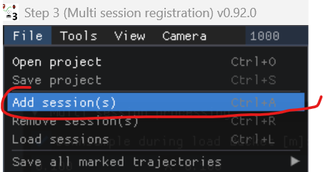
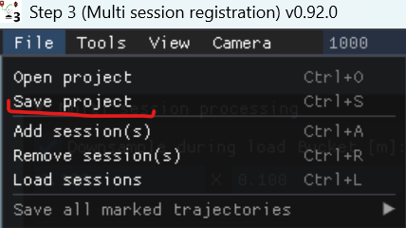
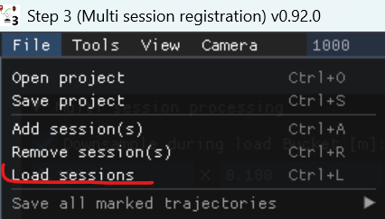
Creating multi session project
1. using multi_session_registration_step_3.exe add session to project
2. Save project
3. Load sessions

Slide 35
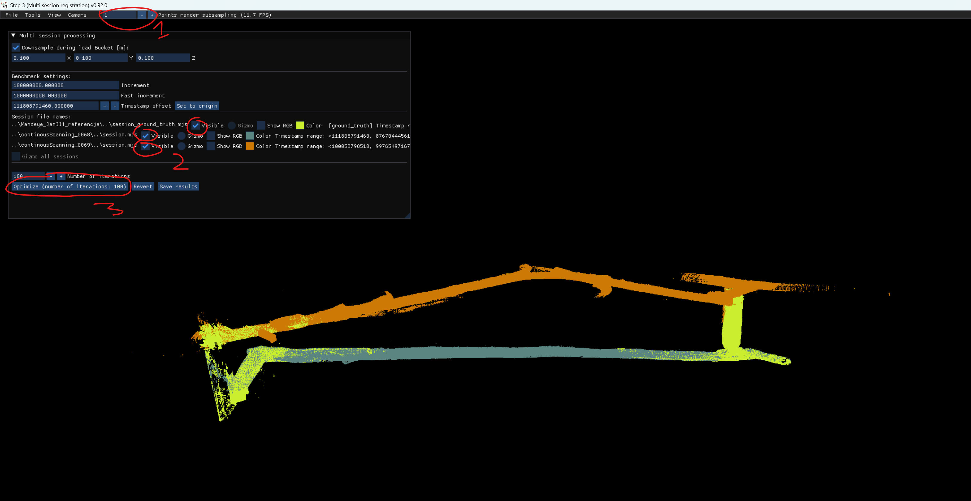
Multi session project – important GUIs
1. downsample point cloud
2. sect sessions to work with (select 1 to work like in step2,
select 2 to add Edge between two sessions)
3. select 3 to apply pose graph slam

Slide 36
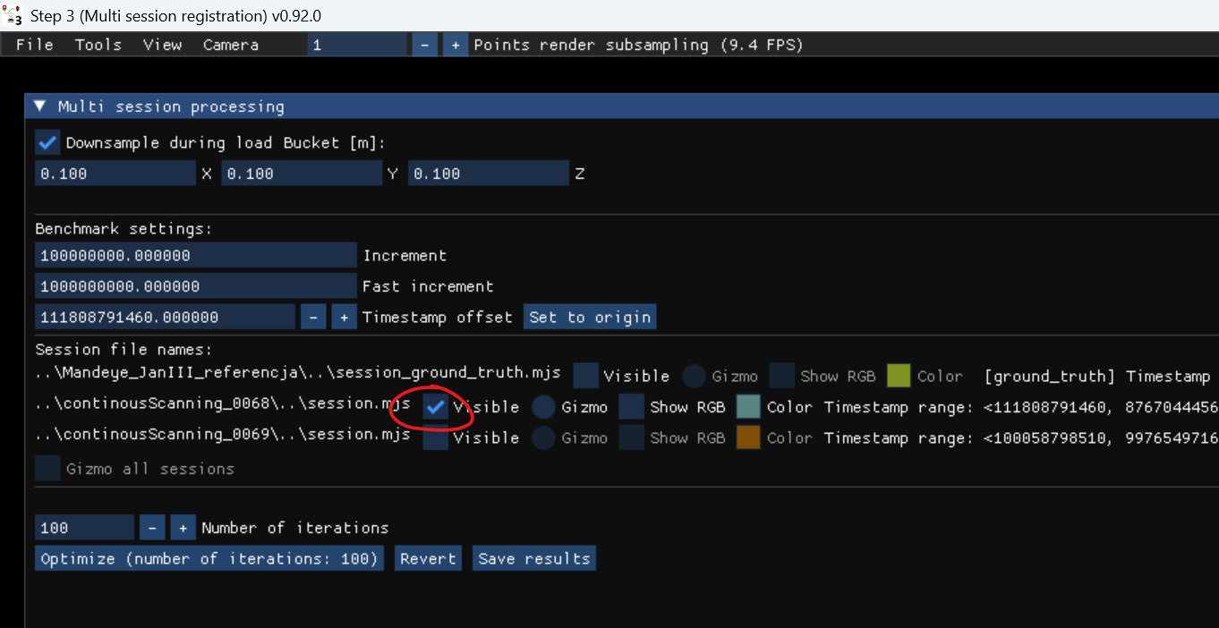
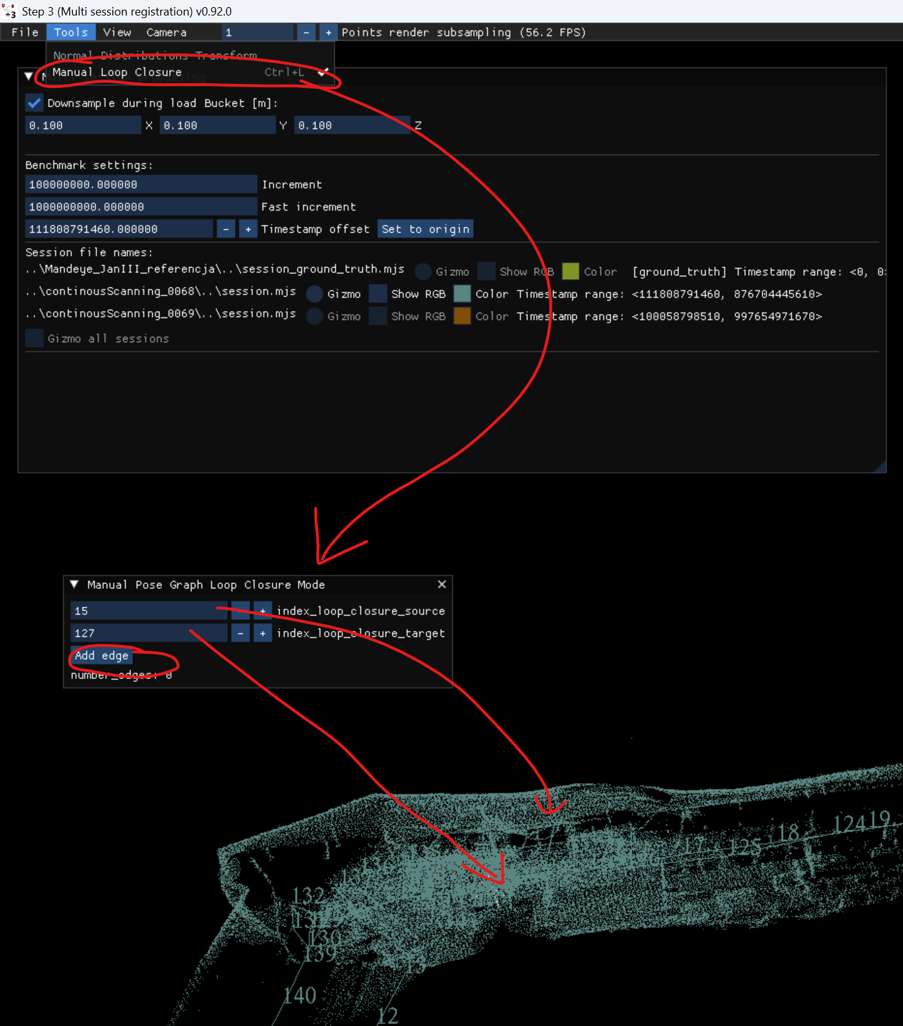
Multi session project – create edge for single point cloud
1. Select 1 session
2. Select Manual Loop Closure
3. Choose 2 nodes
4. Click Add Edge

Slide 37
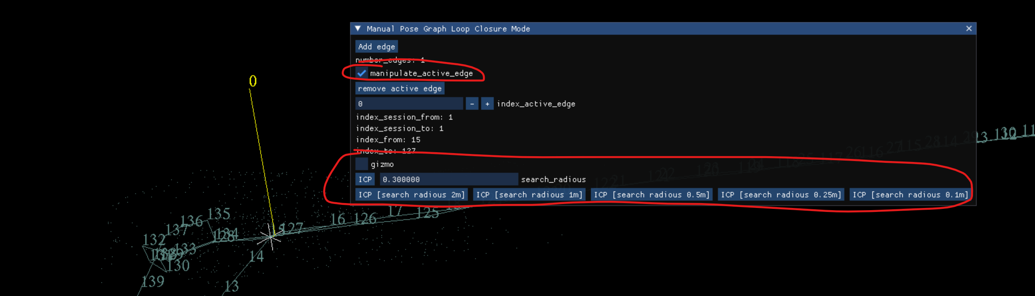
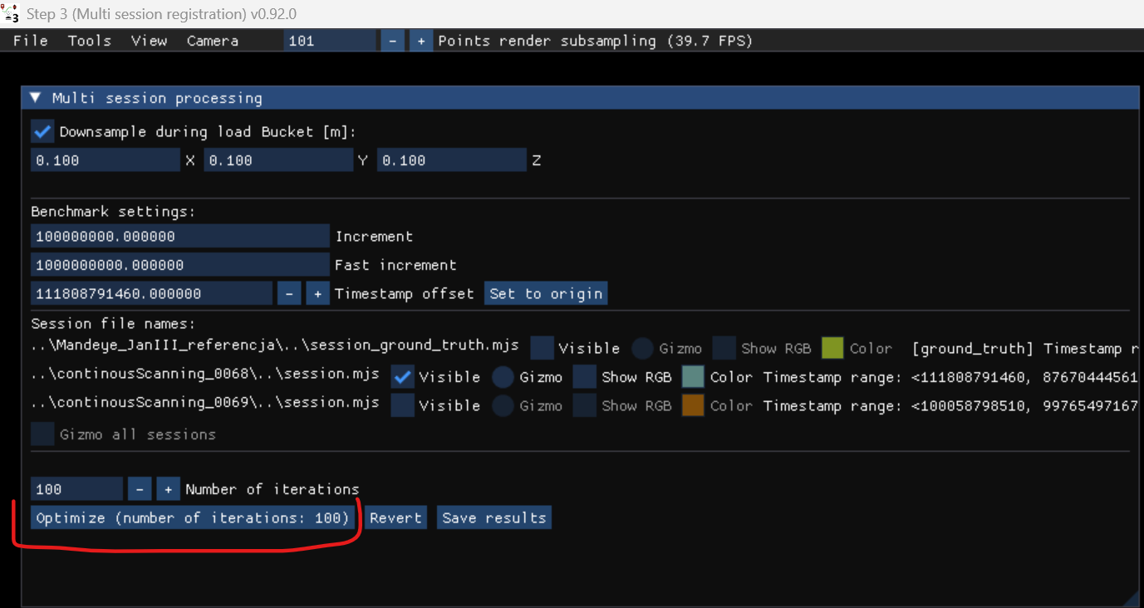
Multi session project – create edge
1. Select manipulate_active_edge
2. Use ICP to align two point clouds
3. Aplly pose graph slam

Slide 38
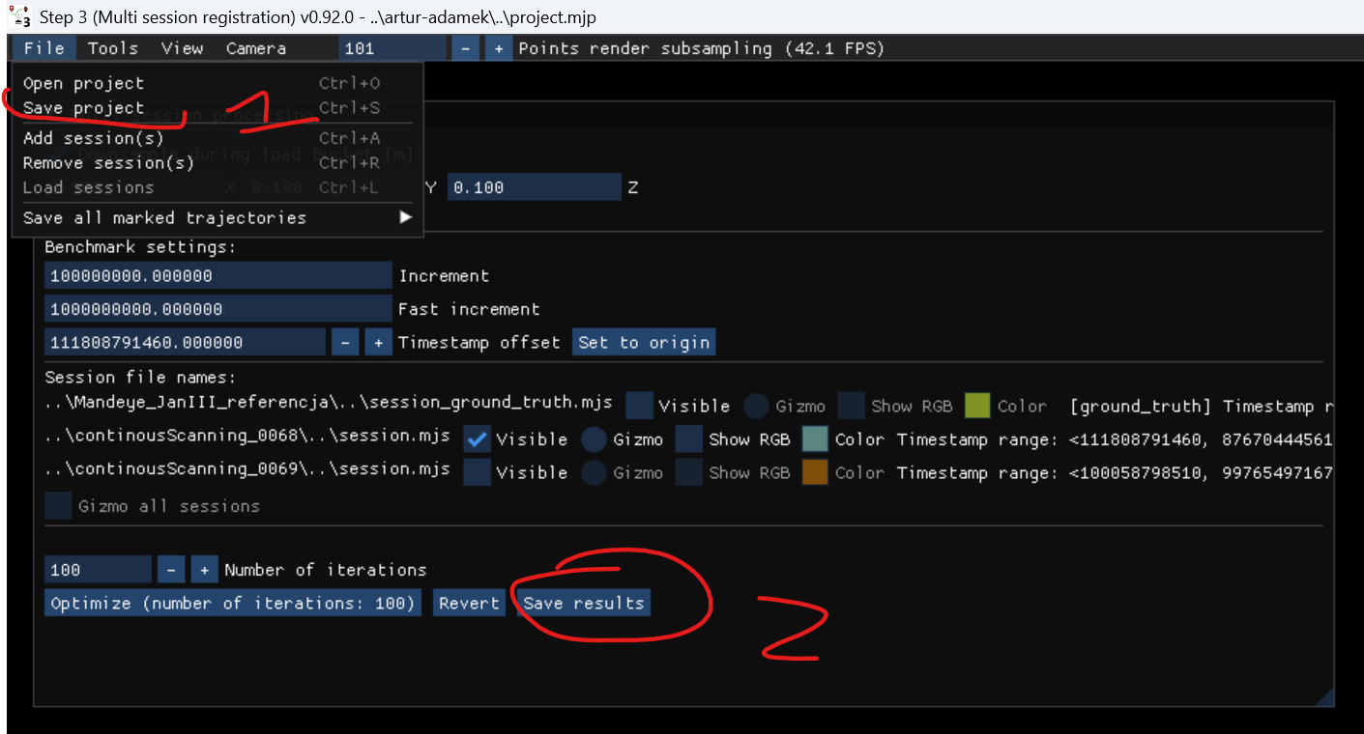
Creating multi session project – save intermediate results
1. Each time you add edge it is advised to save results (two steps)

Slide 39
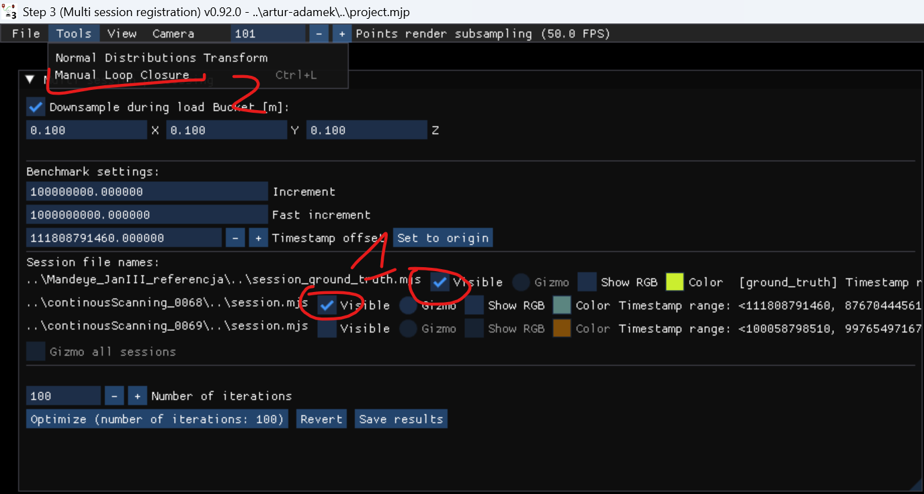
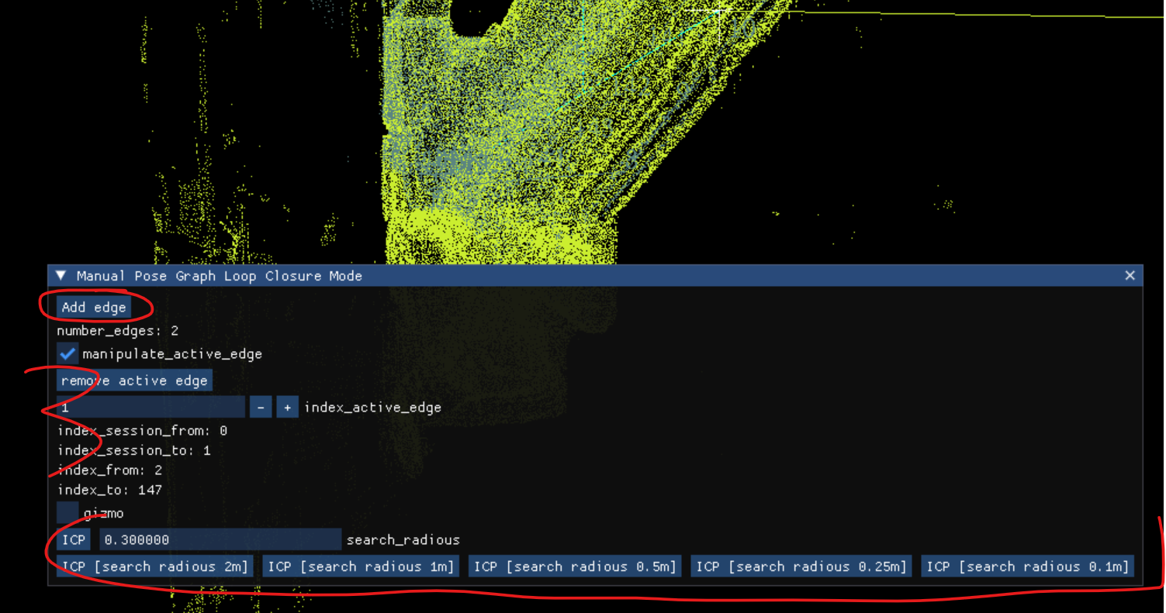
Creating multi session project – create edge for two point clouds
1. Select two point clouds
2. Select Manual Loop Closure
3. Add Edge and use ICP to align two point clouds

Slide 40
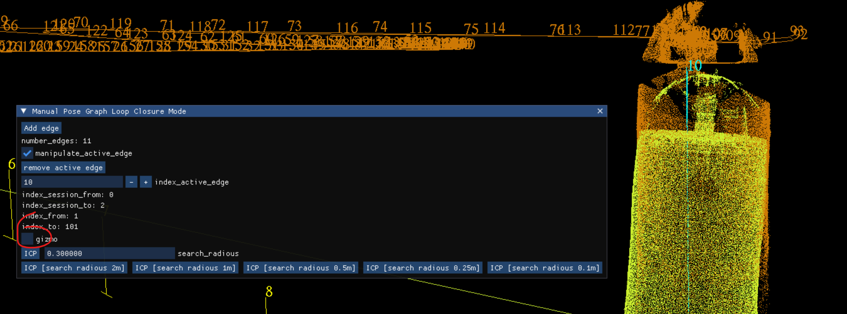
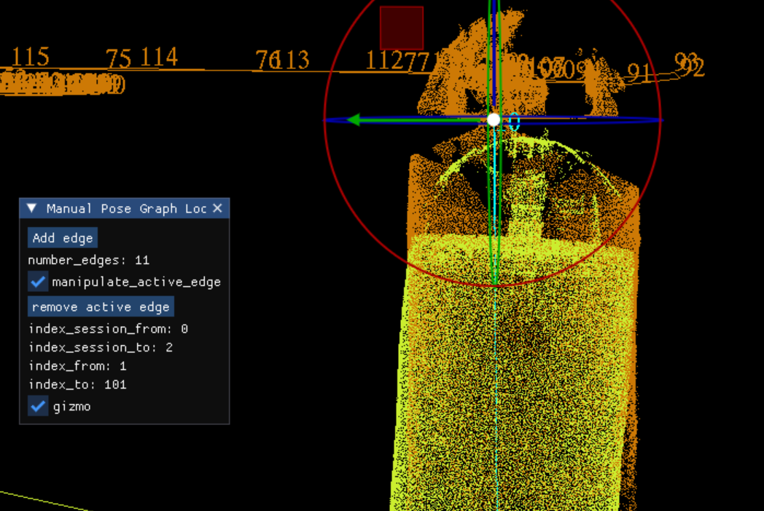
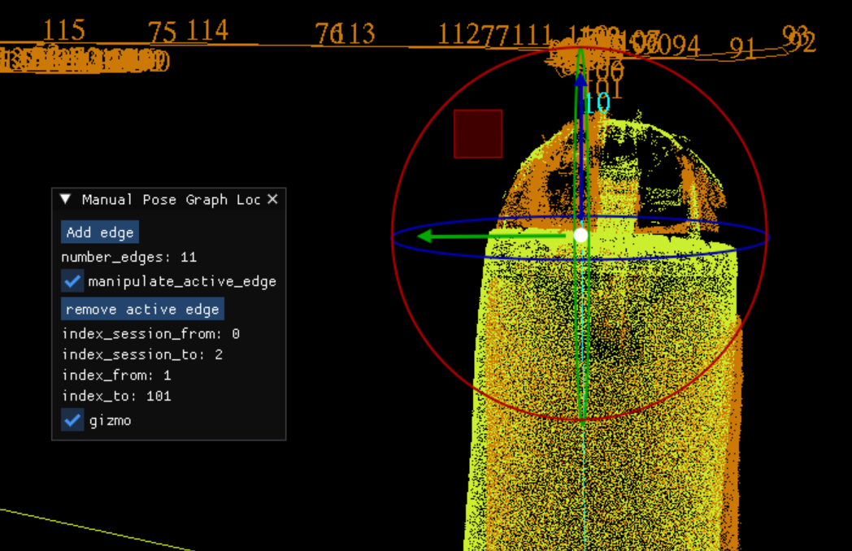
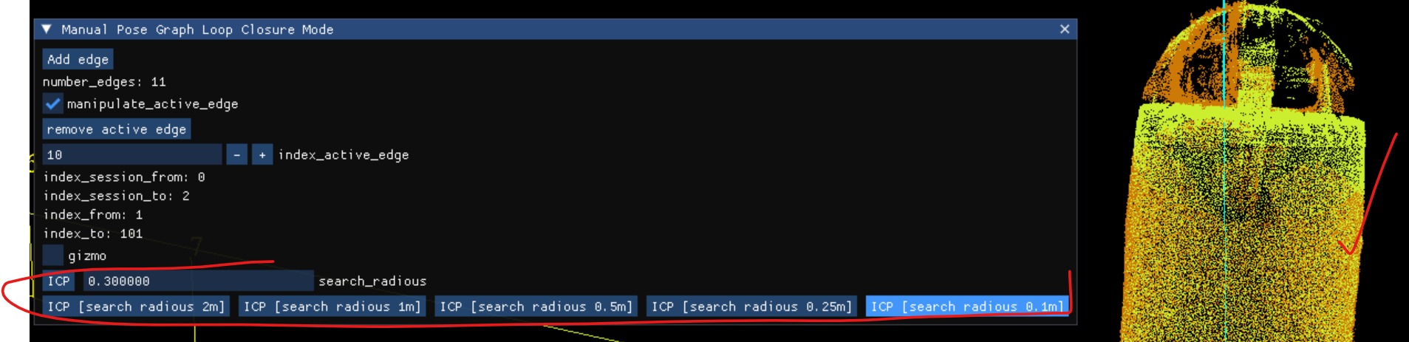
Creating multi session project – manual edge alignment with gizmo
1. Use gizmo to align manually if necessary, finally ICP

Slide 41
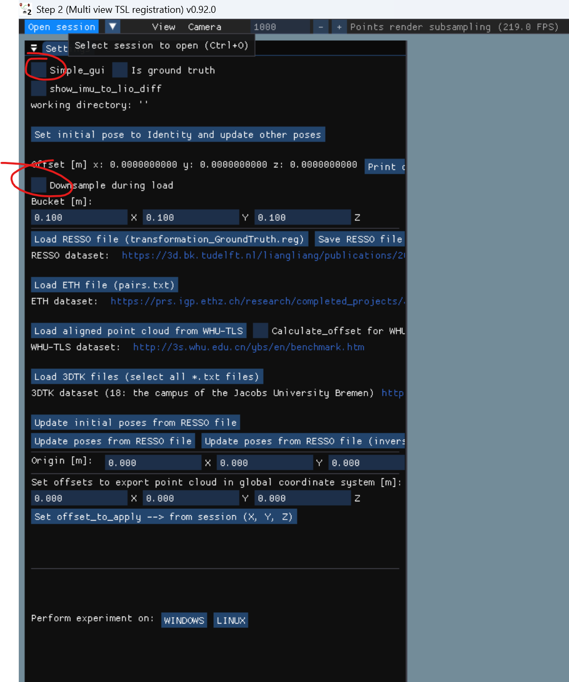
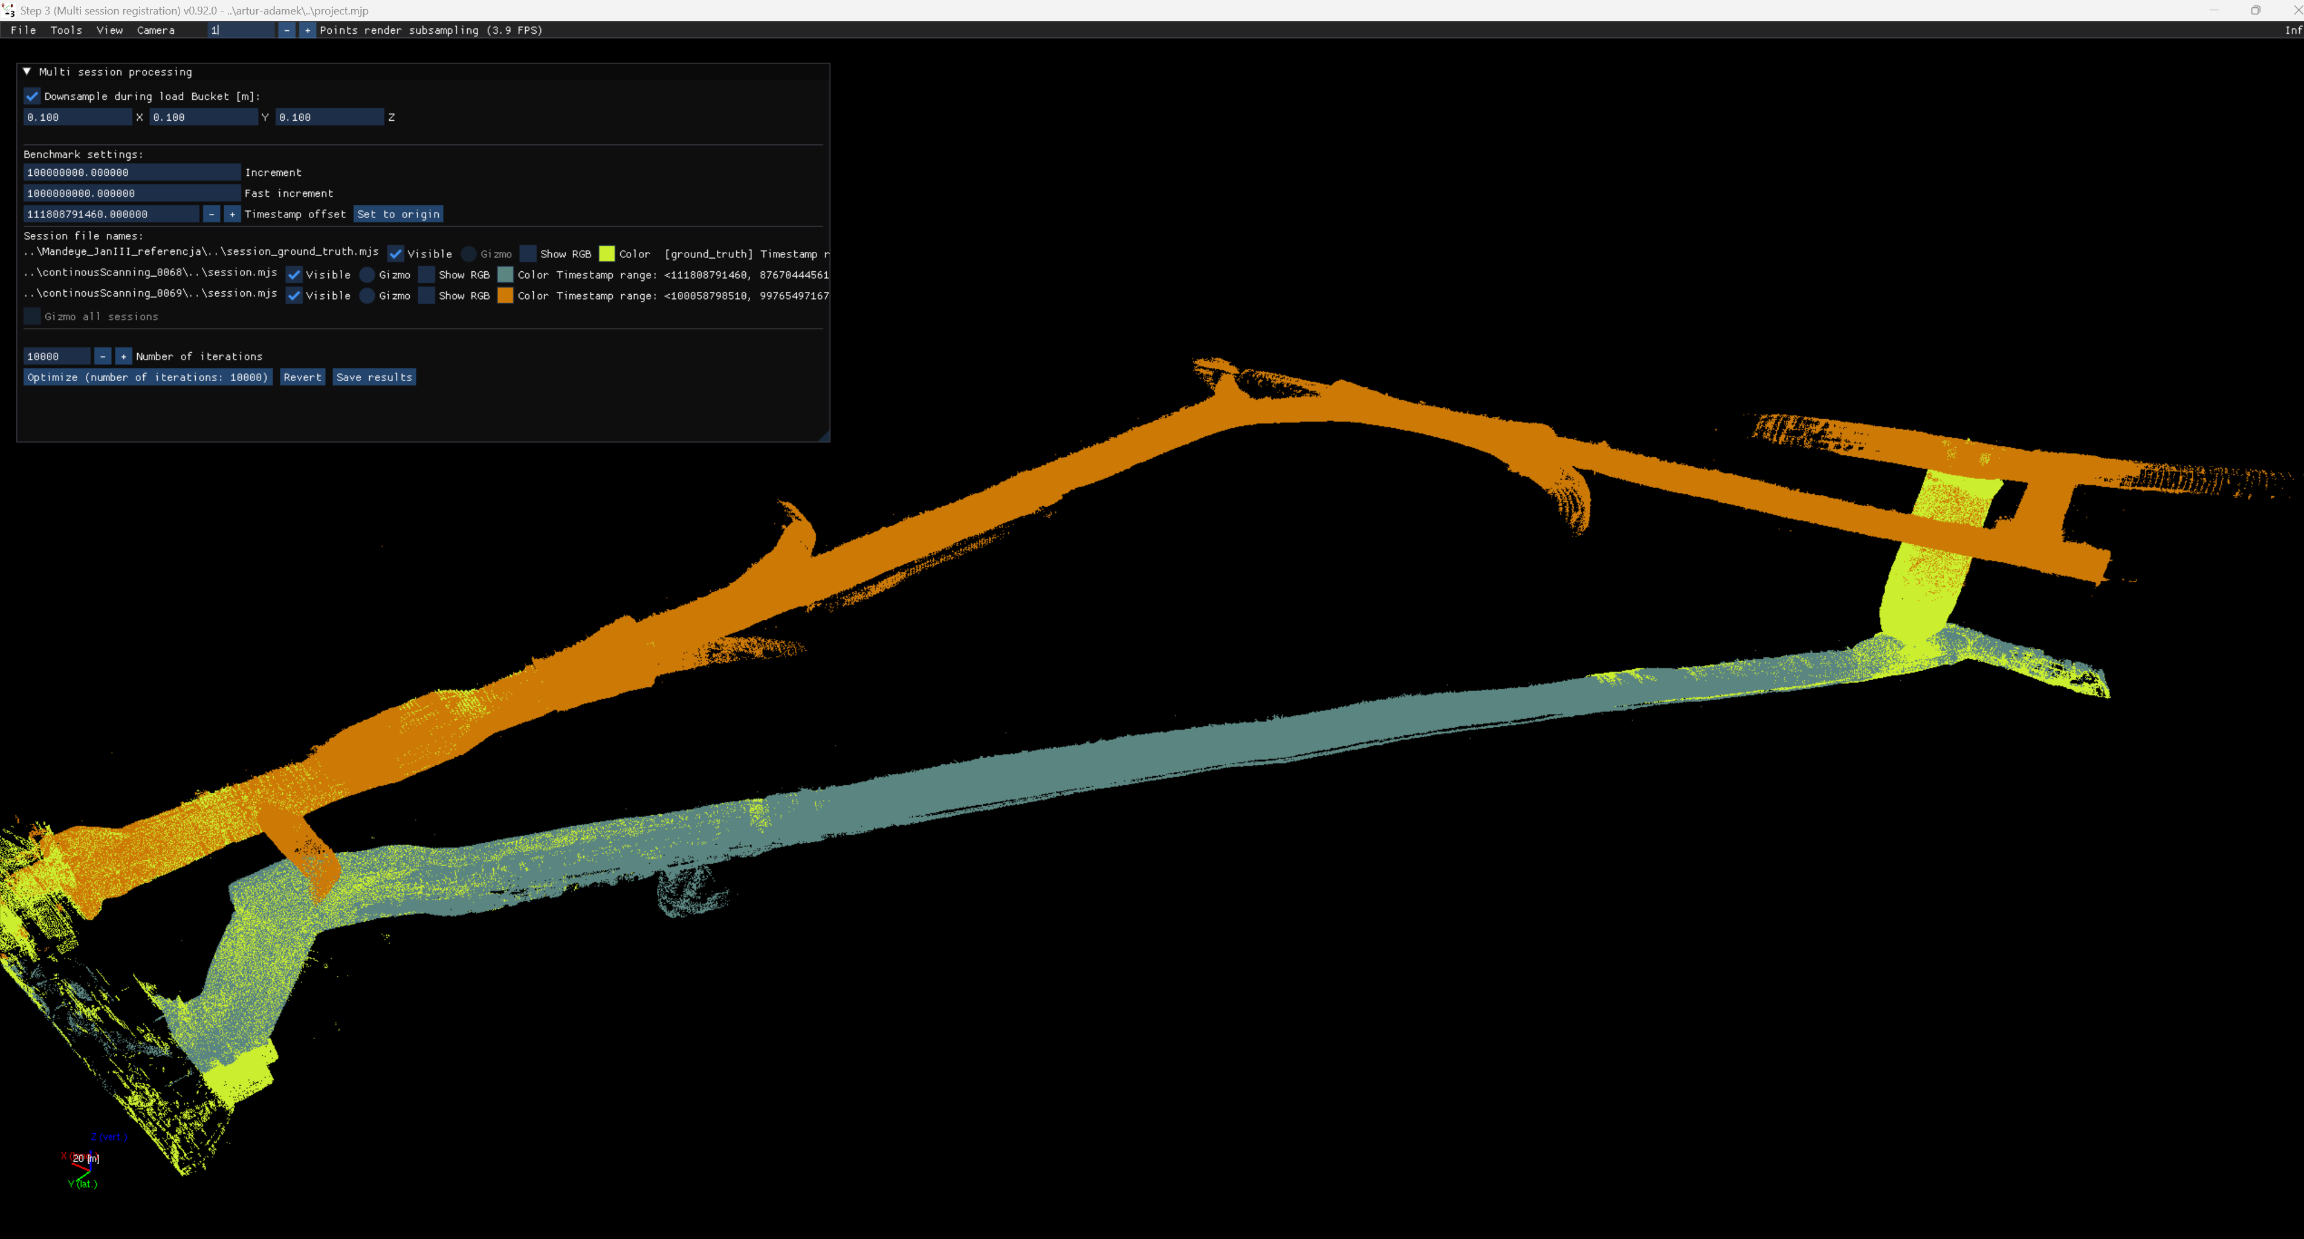
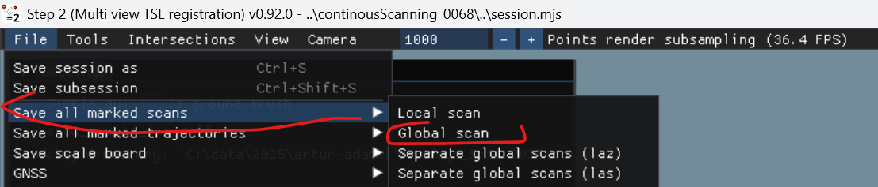
Multi session project - final step
1. Publish data using multi_view_tls_registration_step_2.exe (remember to unmark ‚downsample durig load’)

Slide 42

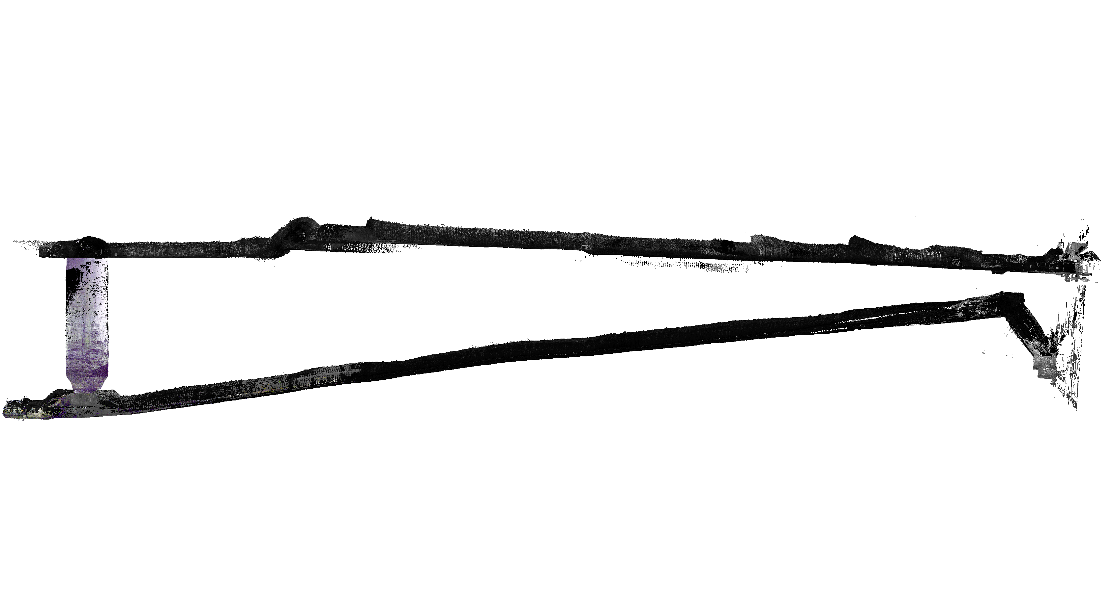
Multi session project - inspect data in CloudCompare

Slide 43
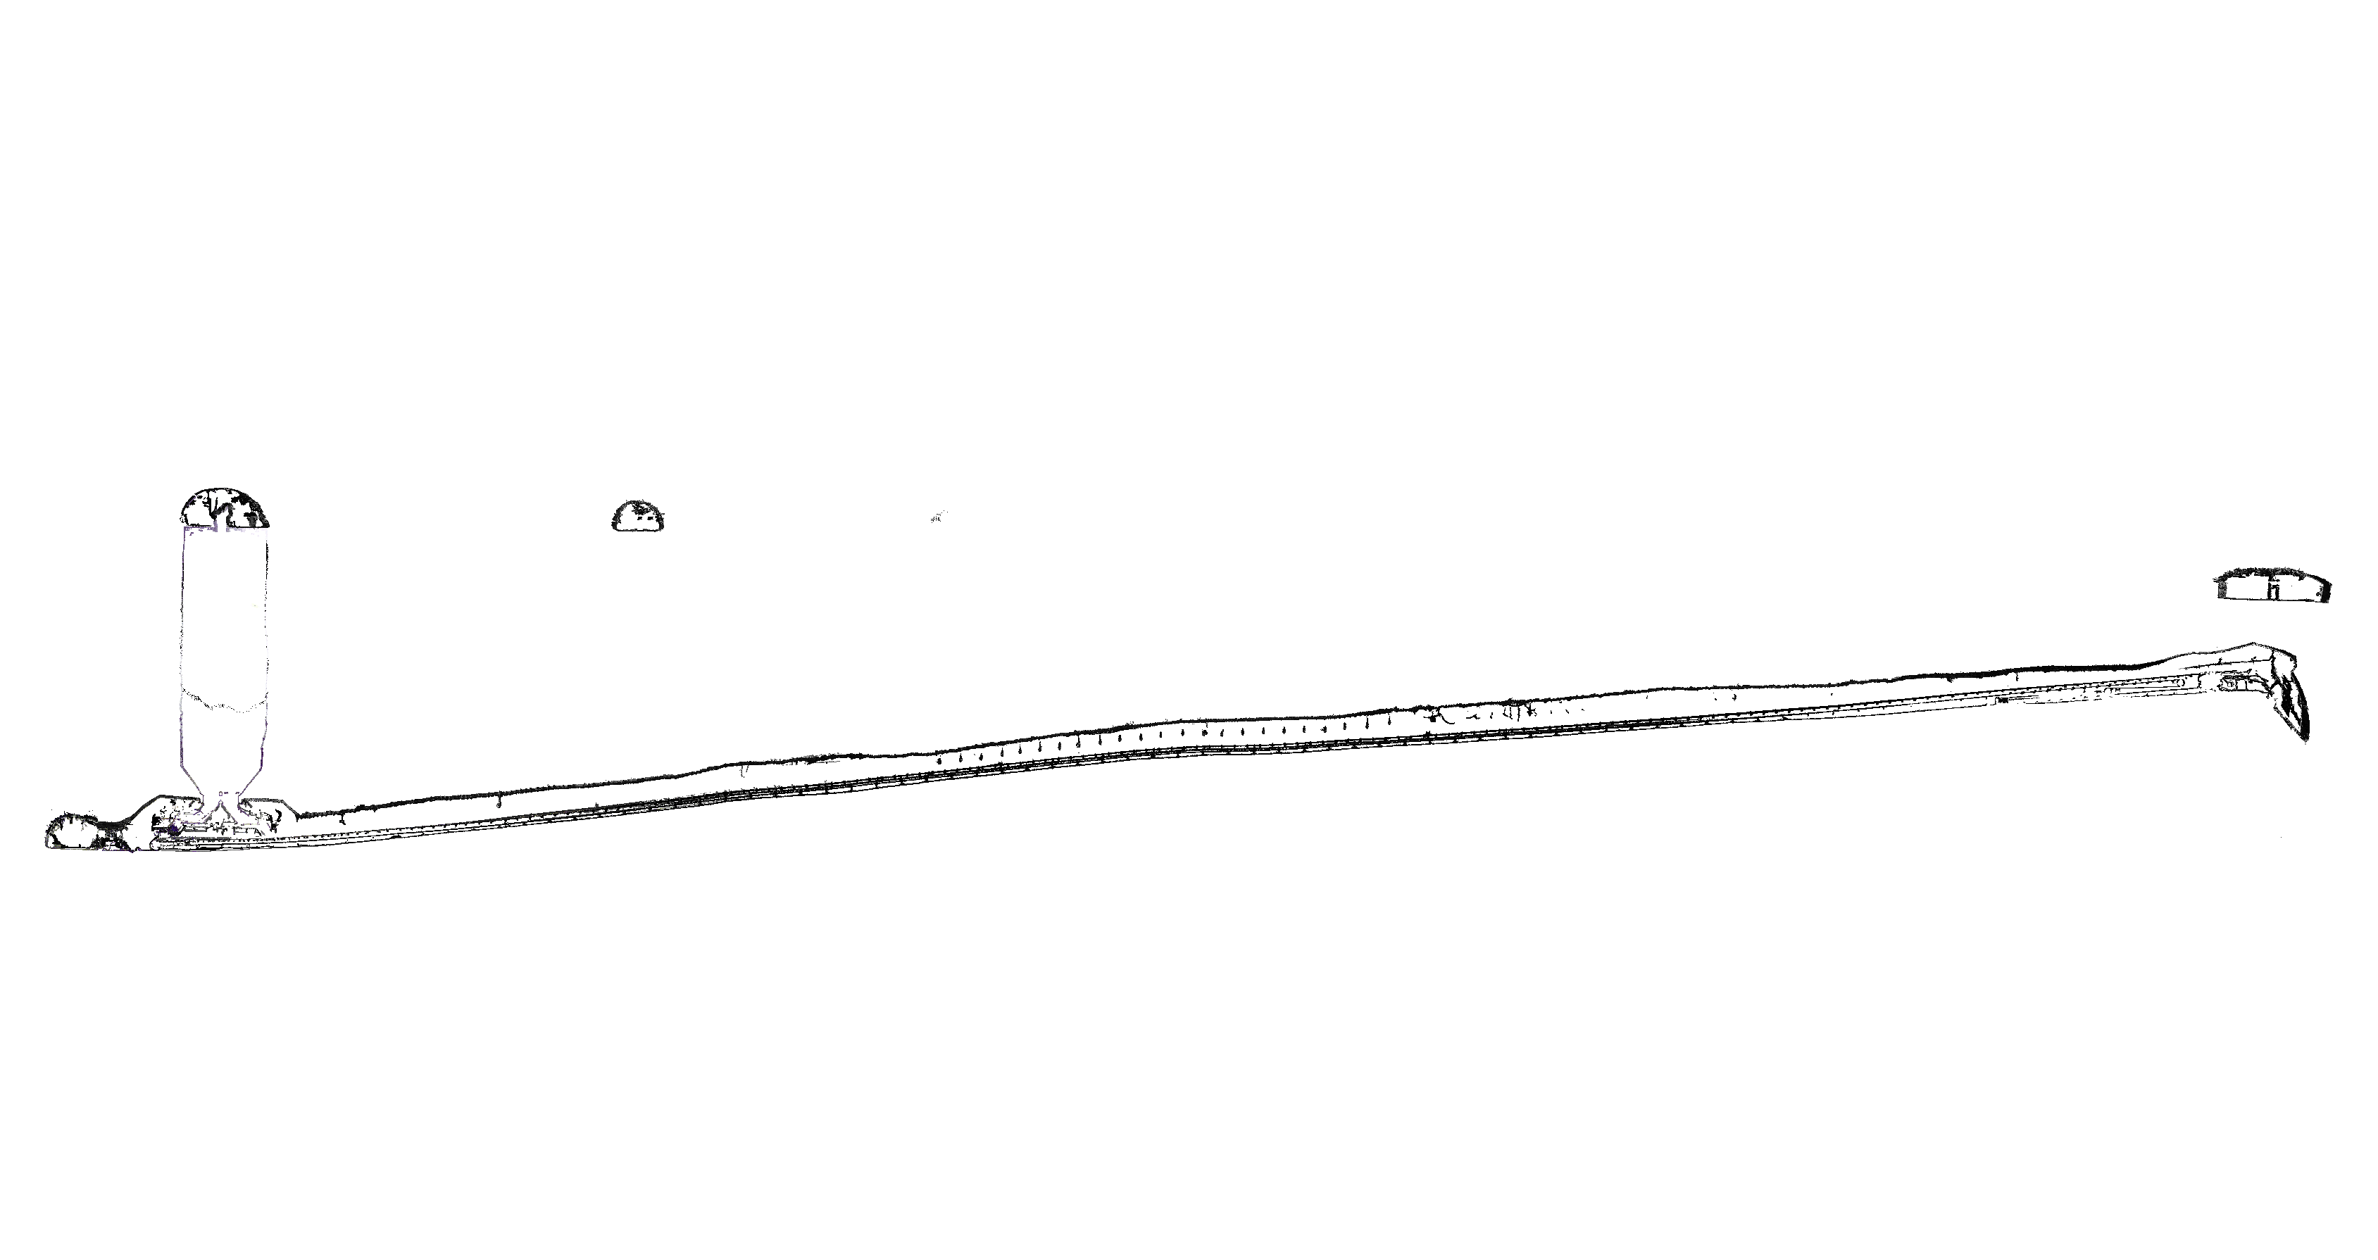
Multi session project - inspect data in CloudCompare

Slide 44

Multi session project - inspect data in CloudCompare

Slide 45

Multi session project - inspect data in CloudCompare

